Slide 1
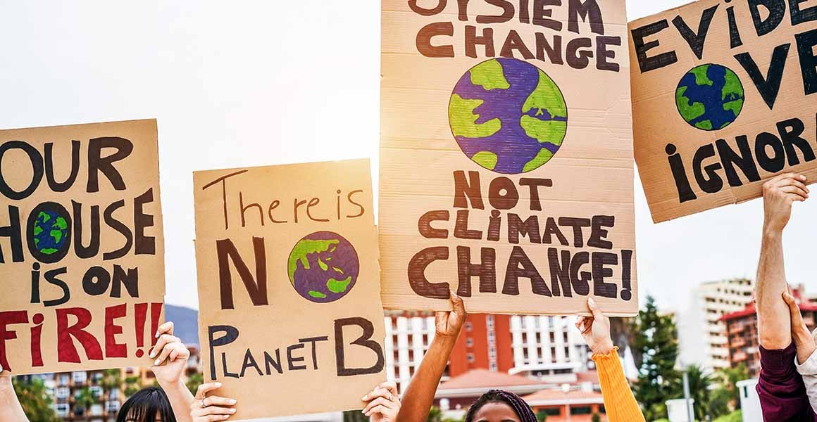
COP26 explained:
What it is and why it's important for tackling climate change
Notes:
Image: DisobeyArt/Shutterstock.com

Slide 2
Contents
Slides 3 & 4: What is COP?
Slides 5 & 6: The Paris Agreement and 1.5°C warming
Slides 7 & 8: Why is COP important?
Slide 9: What was on the agenda at COP26?
Slide 10: Who attended COP 26?
Slide 11: Event logistics
Slide 12: How does COP26 affect you?
Slides 13 - 45: Live blog highlights: What happened at COP26?

Slide 3
What is COP?
The Conference of the Parties (COP) is an annual event that brings governments together to discuss and review how climate change is being managed domestically and internationally.
The first COP meeting was held in 1995 in Berlin, Germany. It is the main decision making body of the United Nations Framework Convention on Climate Change, an agreement made by 197 countries to stabilise greenhouse gas emissions and avoid dangerous climate change.

Slide 4
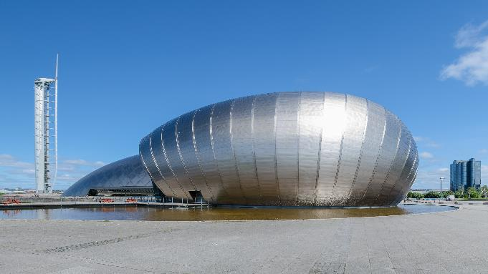
What is COP?
The twenty-sixth COP (COP26) was scheduled to take place in 2020 but it was postponed due to the Covid-19 pandemic. The conference took place from 31 October until 12 November 2021 and was hosted by the UK Government in Glasgow.
COP is held in a different country each year. This year, it was hosted partly in the Glasgow Science Centre shown below.
Notes:
Image: Florian Fuchs, licensed via Wikipedia Wikipedia Commons under CC BY 3.0.

Slide 5
The Paris Agreement and 1.5°C warming
Every year, it is hoped that COP meetings result in agreements between world leaders to take measurable action on tackling climate change. But some meetings run more smoothly than others.
One of the most positive sessions was held in Paris in 2015, which established the Paris Agreement, a legally binding treaty in which leaders pledged to limit global warming.
They promised to try to keep global temperatures to well below 2°C compared to pre-industrial levels, and ideally below 1.5°C.

Slide 6
The Paris Agreement and 1.5°C warming
The Industrial Revolution began in Britain in the 1700s, and it marked the start of major greenhouse gas emissions. As emissions rise, our world keeps getting hotter.
At the moment, the world is on track to get 1.5°C hotter by the 2030s. If Earth gets even hotter still, disasters are likely to unfold around the planet. Every fraction of a degree's warming will make a huge difference to our future, so it was a big moment when leaders agreed to aim for 1.5°C.
The treaty was signed by 196 countries. It included rich countries offering financial assistance to poorer countries to reduce emissions. The treaty is assessed every five years and was one of the main discussions of COP 26.

Slide 7
Why is COP important?
Climate change is one of the biggest challenges of our time and it demands global collaboration.
COP provides an organised environment for parties to gather and discuss how best to tackle climate change together. It brings together rich and poor countries, high emitters and low emitters.
Agreements come to fruition from consensus and while this can mean slow process, it also means decisions made at COP have global authority.

Slide 8
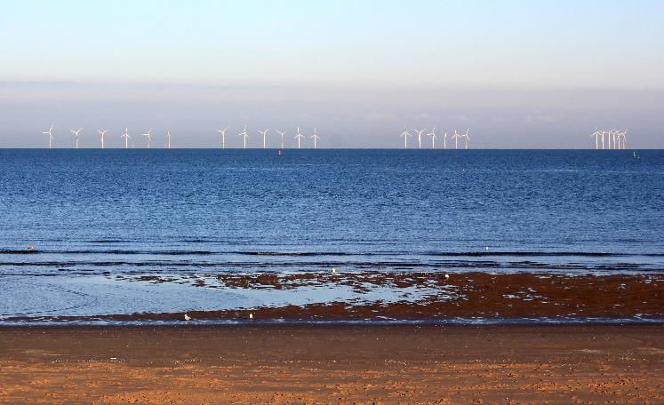
Why is COP important?
In 2015, governments also promised to make adjustments in various sectors within their own countries to reduce carbon emissions, known as nationally determined contributions (NDC).
These national targets agreed in Paris didn't go far enough to reduce greenhouse gas emissions. Countries were urged to improve on them for COP26 in 2021.
Notes:
North Hoyle offshore wind farm in Wales. Wind power delivers large amounts of clean energy.
Image: Kaly99 licensed via Wikimedia Commons under CC-BY-SA-3.0.

Slide 9
What was on the agenda at COP26?
The Paris Agreement is assessed every five years. COP26 was the first time the treaty was revisited and countries were required to show how they have met their national targets. Many saw COP26 as the last chance to keep hopes alive of limiting warming to 1.5°C.
Countries were asked to bring plans to help the world reach net-zero by the middle of this century. Ultimately, that means phasing out fossil fuels like coal and gas and switching to renewable energy.
The UK Government also asked representatives to discuss the protection of nature, and the financial investment needed to make real change.

Slide 10
Who attended COP26?
For two weeks, government representatives descended on Glasgow, together with roughly 30,000 negotiators, scientists, businesspeople, activists and policy makers.
Prominent people attending the conference included Boris Johnson, Sir David Attenborough, Her Majesty The Queen, Pope Francis and Greta Thunberg. US President Joe Biden also attended after re-joining the Paris Agreement.
British politician Alok Sharma acted as the President of COP26 which means he no longer represented the UK. Instead, he acted as a neutral and impartial COP official. The President's role involves opening and closing meetings, determining order of speakers and helping to steer discussions towards successful outcomes.

Slide 11
Event logistics
The event was split into two zones. The blue zone was held in the Scottish Event Campus and managed by the United Nations. This is where official COP members were, and negotiations and assessments took place.
The green zone was open to the public, including artists and academics. It was held in the Glasgow Science Centre, which includes a 370-seat IMAX auditorium. The space aimed to promote learning and participation around climate change through workshops, exhibitions and discussion groups.

Slide 12
How does COP26 affect you?
The pledges made at summits like COP affect us all. Governments will be looking to take action in their own countries.
In the UK, it has been made law that the country becomes carbon neutral by 2050. Only radical change can get us there. Government and big business are a key part of the journey, but individuals will also play a role.
Several changes for consumers are on their way over the coming decades. For instance, the sale of new petrol and diesel cars will be banned from 2030, and there is a proposal to ban new gas-powered boilers in homes in favour of low-carbon alternatives.

Slide 13
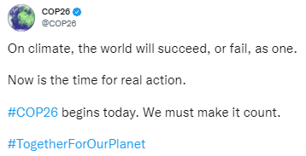
What happened at COP26?
Take a look at some of the key events from COP26 from the NHM live blog, as reported by the NHM team in Glasgow...

Slide 14
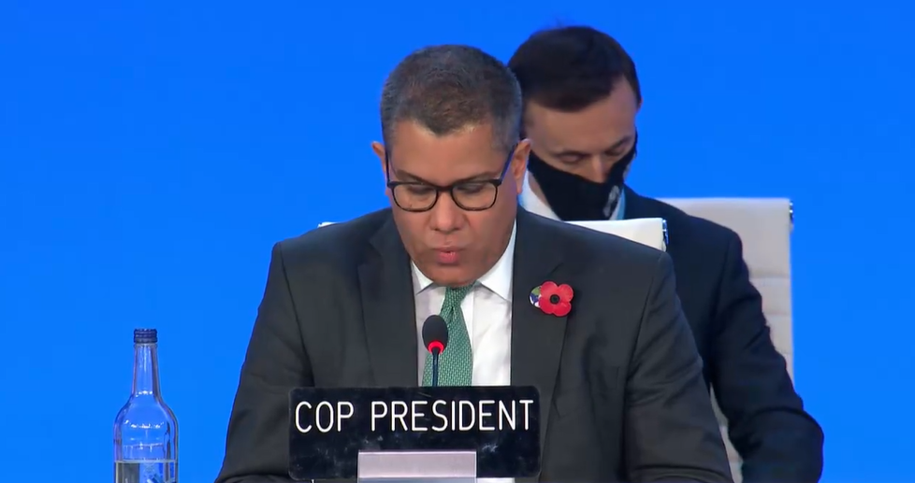
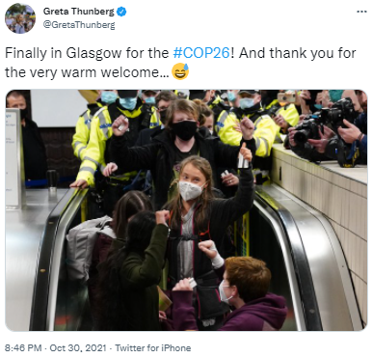
'Act now to keep 1.5C alive'
Watch Alok Sharma's full opening address on the UN website here:
https://unfccccop26.streamworld.de/webcast/opening-plenary-of-the-cop-followed-by-cmp-and-cma

Slide 15
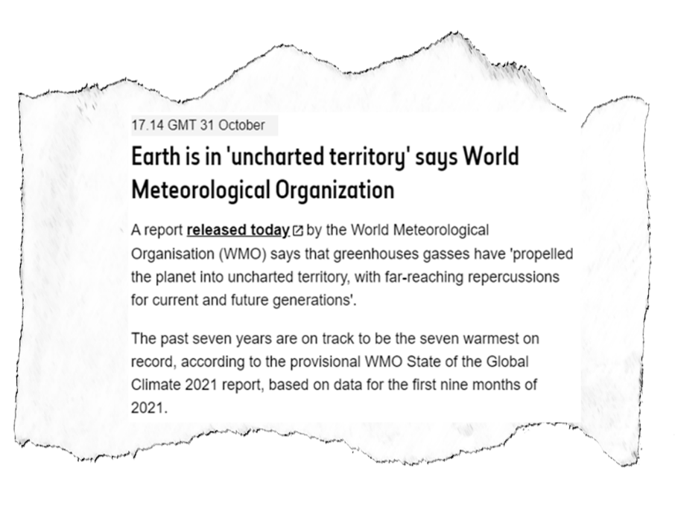
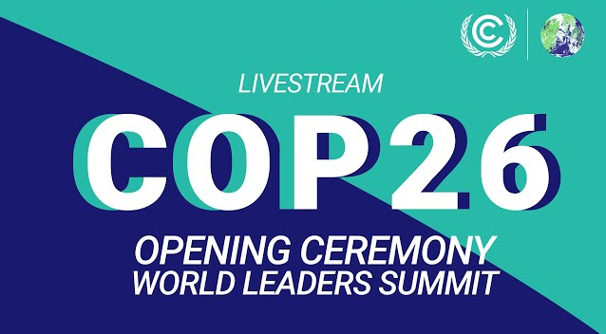
​COP26 opening ceremony
Watch UK prime minister Boris Johnson and Prince Charles address the attendees here via the official COP26 YouTube channel:
https://public.wmo.int/en/media/press-release/state-of-climate-2021-extreme-events-and-major-impacts
​Read the State of Global Climate 2021 report here: ​
https://public.wmo.int/en/media/press-release/state-of-climate-2021-extreme-events-and-major-impacts

Slide 16
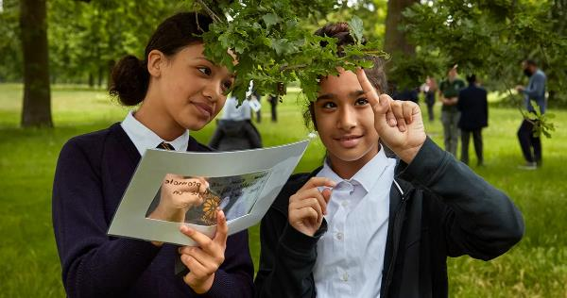
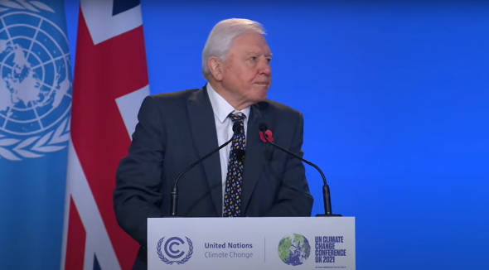
​'If COP26 talks fail, it is the planet’s young people who will live with the consequences.'
Find out how we are empowering younger generations to speak about their views on the planetary emergency here:
https://naturalhistorymuseum.blog/2021/10/27/empowering-young-voices-on-the-planetary-emergency-executive-director-of-engagement/#more-15847
Sir David Attenborough urges governments to 'restore the wild'
https://www.youtube.com/watch?v=o7EpiXViSIQ

Slide 17
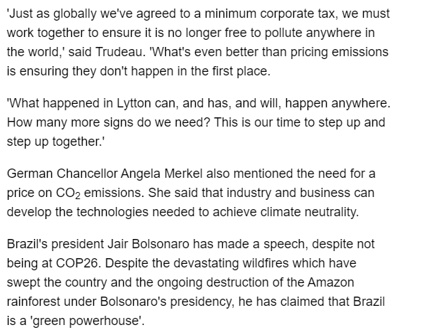
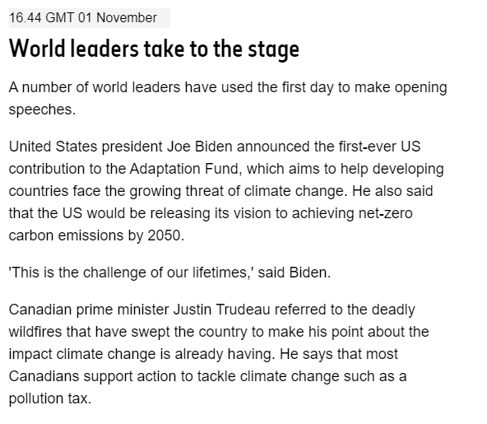

Slide 18
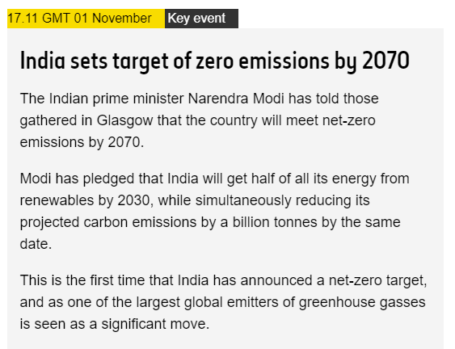
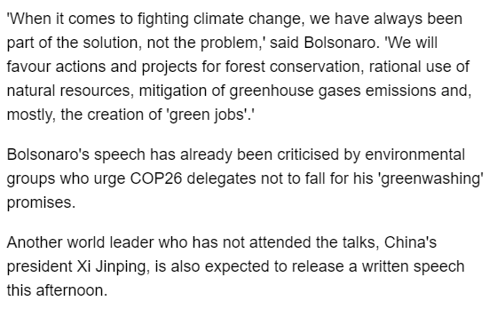

Slide 19
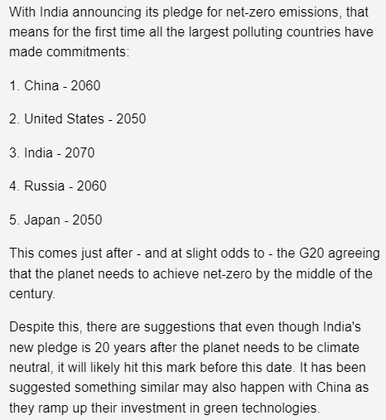
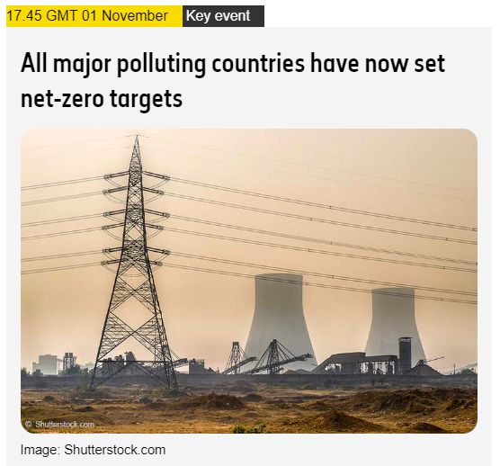

Slide 20
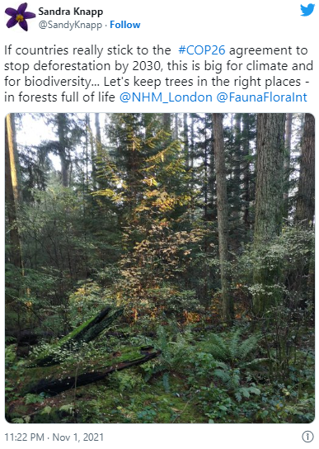
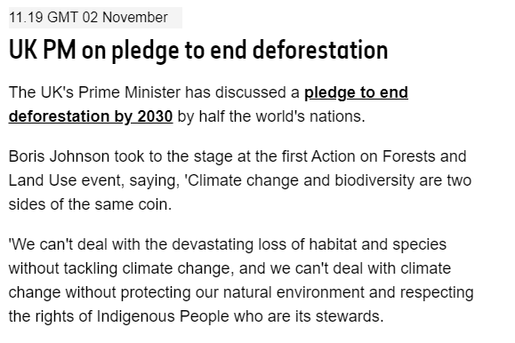

Slide 21
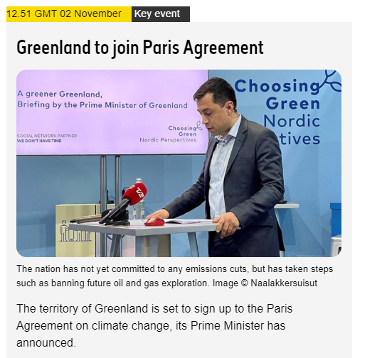
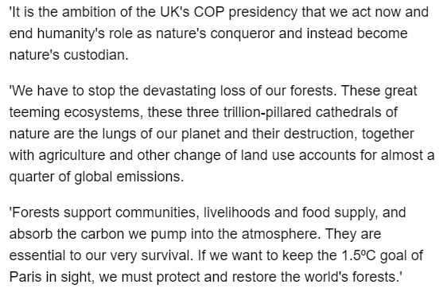

Slide 22
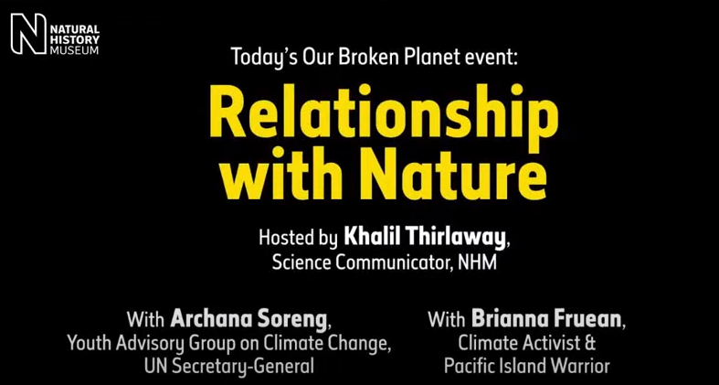
Relationship with Nature video link:​
https://www.youtube.com/watch?v=1OtUv2Om-6Q

Slide 23
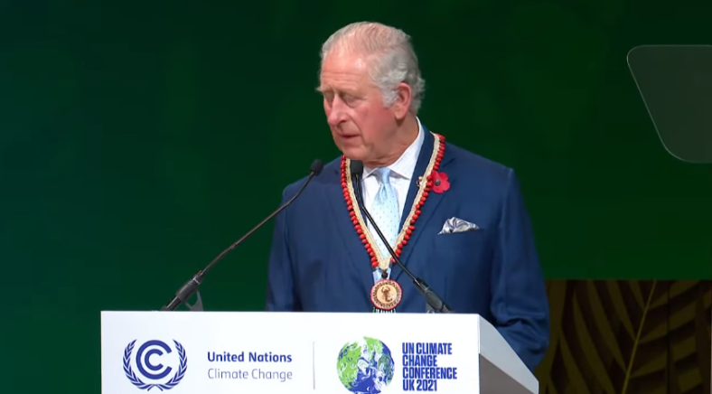
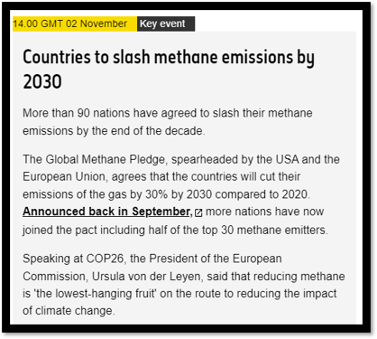
Prince Charles calls for restructuring of economy to protect nature
https://www.youtube.com/watch?v=Zj07QioIcW0

Slide 24
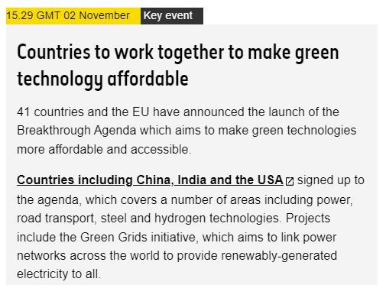
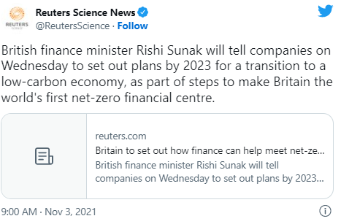
https://www.reuters.com/business/cop/britain-set-out-how-finance-can-help-meet-net-zero-goals-2021-11-02

Slide 25
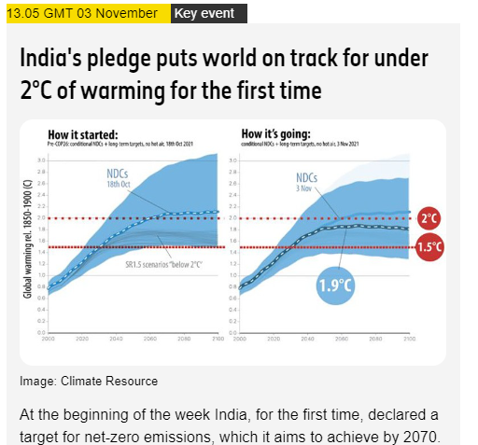

Slide 26
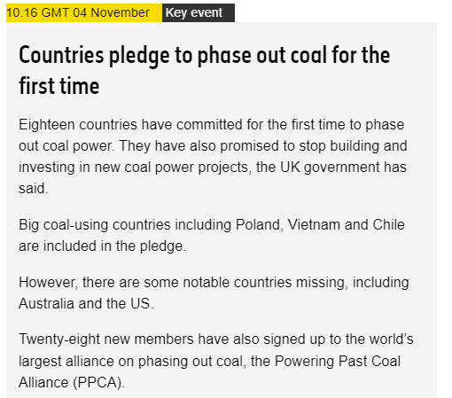
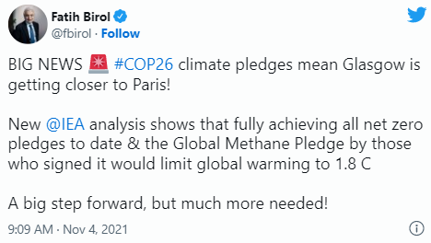

Slide 27
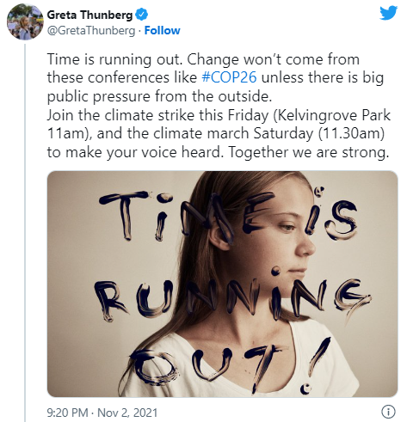
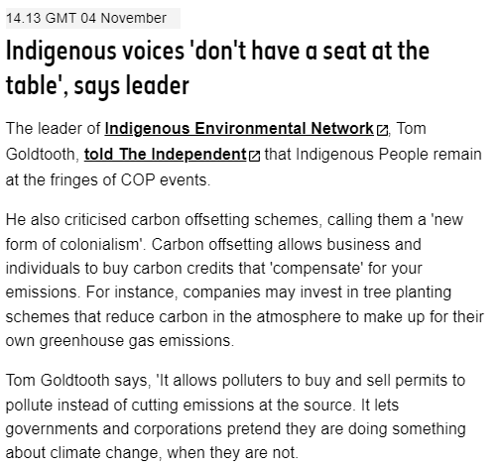

Slide 28
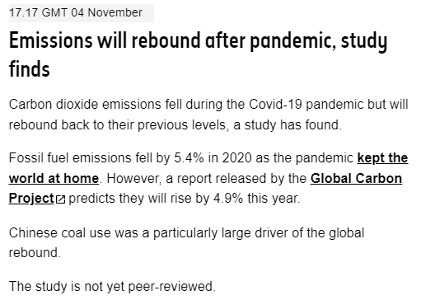
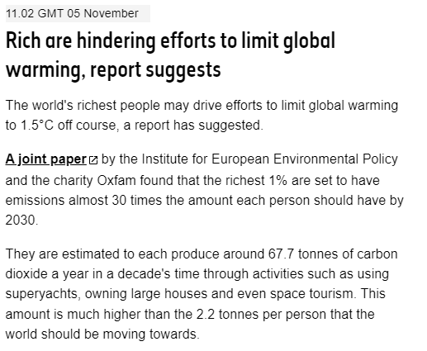

Slide 29
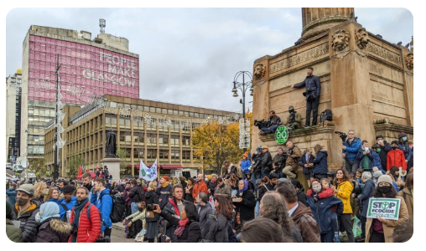
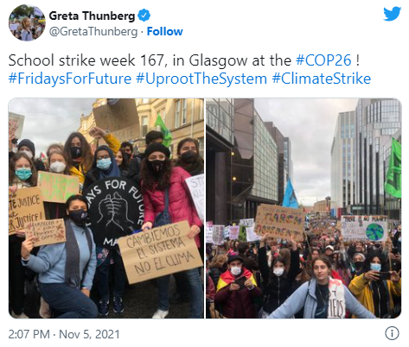
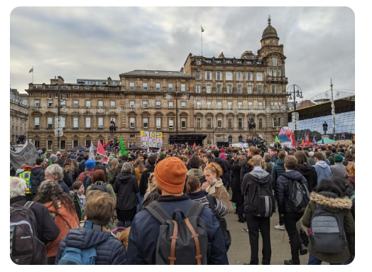
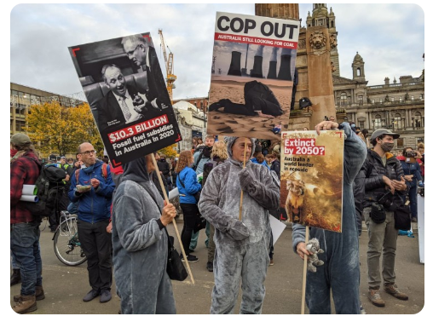

Slide 30
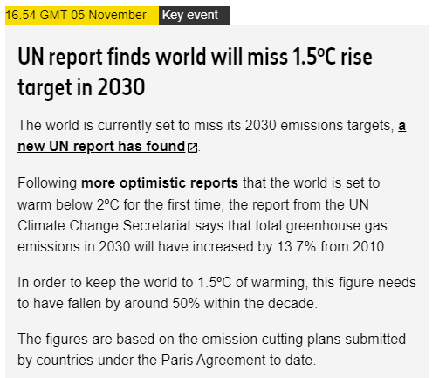
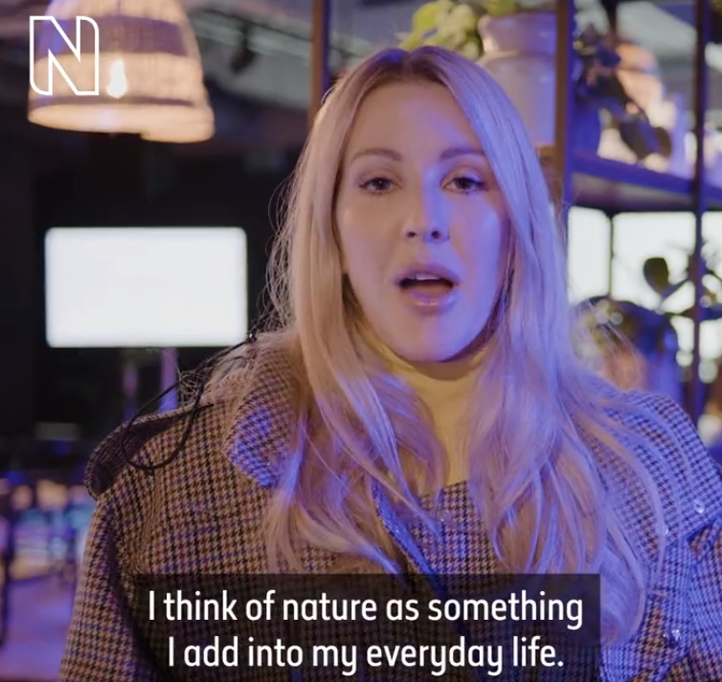
https://twitter.com/NHM_London/status/1456983633248595971

Slide 31
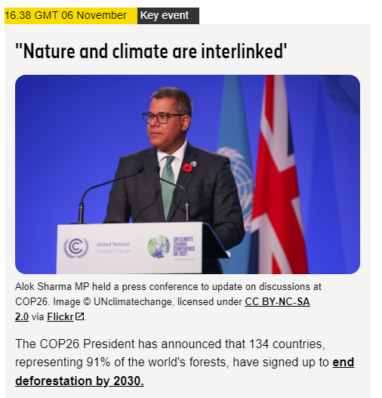
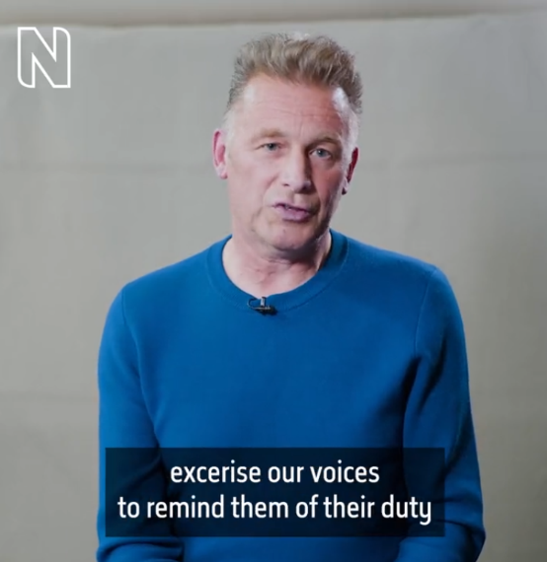
https://twitter.com/NHM_London/status/1457362140814323739

Slide 32
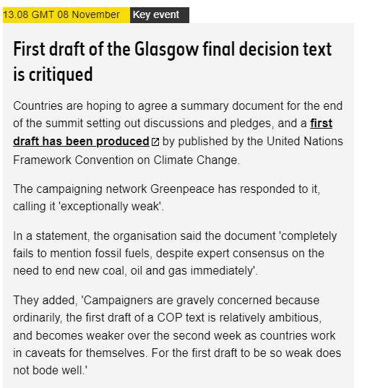
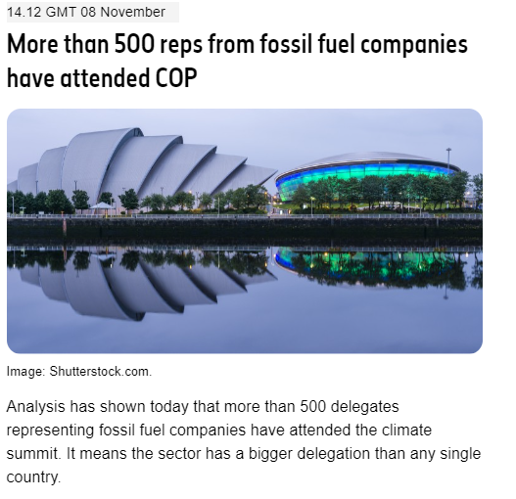

Slide 33
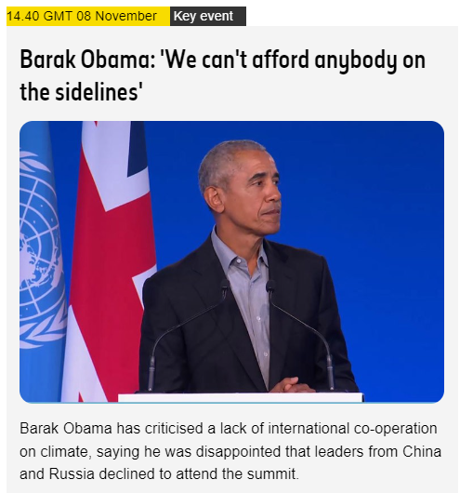
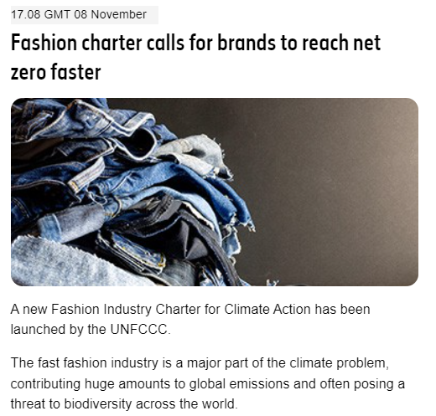

Slide 34
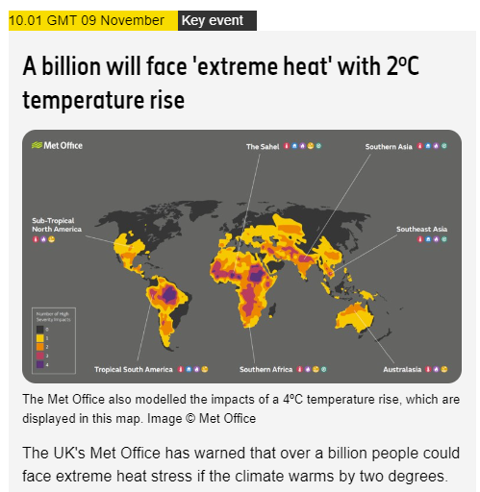

Slide 35
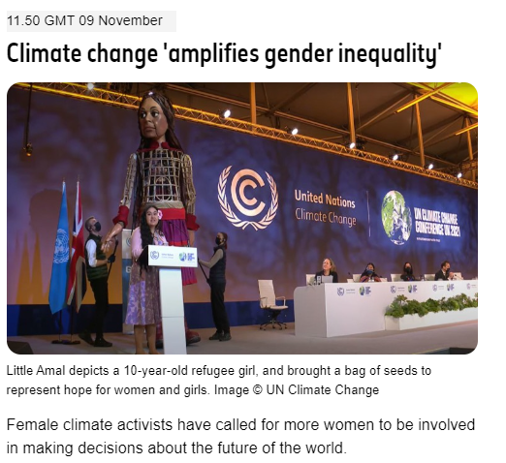
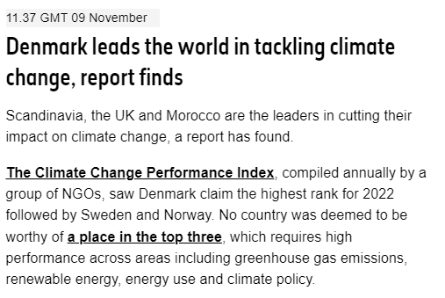

Slide 36
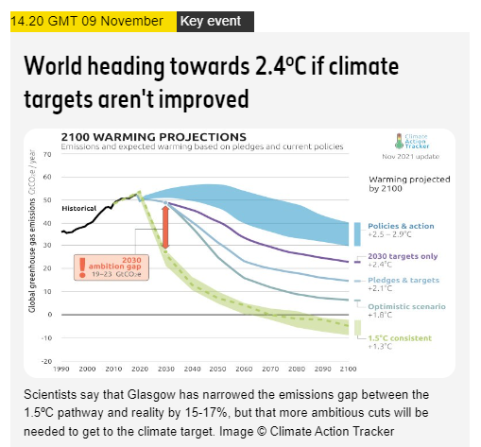
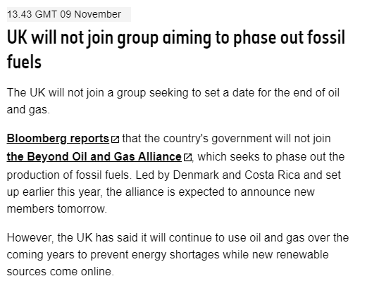

Slide 37
