Slide 1

and the natural world
Classroom resources

Slide 2
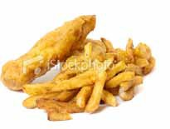
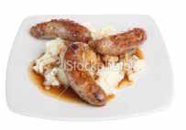
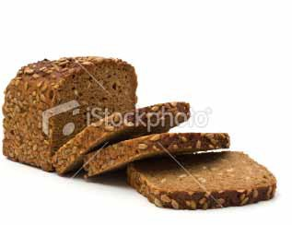
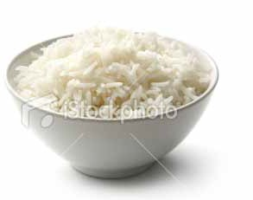
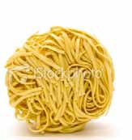
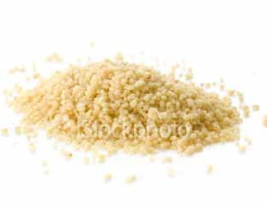
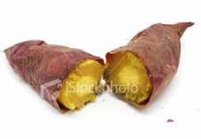
Resource Bank 1 – Traditional staple foods from around the world
Classroom resources
Traditional staple British foods
Fish and chips
Sausages and mash
Brown bread
Traditional staple Asian foods
Rice
Noodles
Traditional African foods
Couscous
Cooked potato

Slide 3
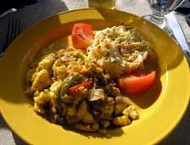
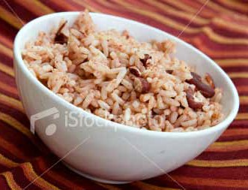
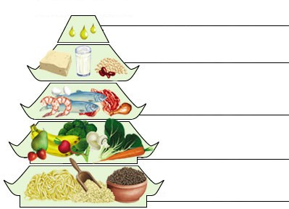
Classroom resources
Traditional staple Caribbean foods
Ackee and saltfish
Rice and beans
Resource Bank 2 – Standard food advice from Asia and Europe
Chinese food pagoda
fats and oils, 25g
milk and dairy products, 100g beans and bean products, 50g
meat and poultry, 50–100g fish and shrimp, 50g
eggs, 25–50g
vegetables 400–500g fruits, 100–200g
cereals, 300–500g

Slide 4
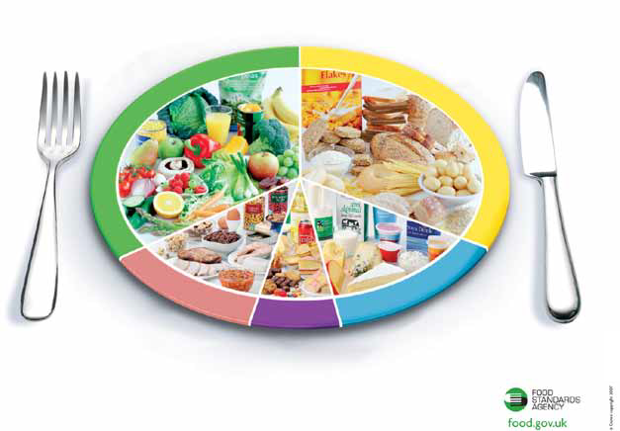
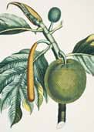
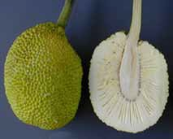
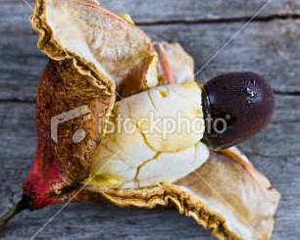
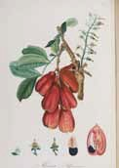
Classroom resources
The eatwell plate from the Food Standards Agency, UK
Use the eatwell pate to help you get the balance right.
It shows how much of what you eat should come from each food group.
Fruit and vegetables
Bread, rice, potatoes, pasta
and other starchy food
Meat, fish, eggs, beans and other non-dairy sources of protein
Milk and dairy foods
Foods and drinks high in fat and/or sugar
Resource Bank 3 – Foods from the time of the slave trade
Breadfruit
Ackee

Slide 5
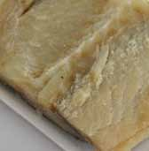
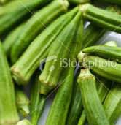
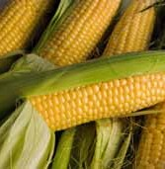
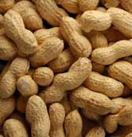
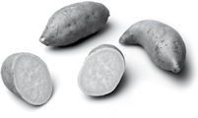

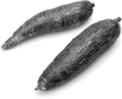

Classroom resources
Saltfish
Okra
Maize/ sweetcorn
Peanuts
Resource Bank 4 – Nutritional content of foods and GDAs
Nutrition information supplementary
Nutrition information supplementary
Nutrition information supplementary
Sweet Potato
Typical composition | Per 100g
Energy | 359Kj
Protein | 1.6g
Carbohydrate | 24g
Fat | 0.05g
Fibre | 3g
Vitamins Vit B1 (thiamin) | 0.08mg
Vit C | 2.4mg
Minerals Iron | 0.6mg
Yam
Typical composition | Per 100g
Energy | 159Kj
Protein | 0.7g
Carbohydrate | 10g
Fat | 0.09g
Fibre | 4.9g
Vitamins Vit B1 (thiamin) | 0.02mg
Vit C | 20mg
Minerals Iron | 0.6mg
Cassava
Typical composition | Per 100g
Energy | 667Kj
Protein | 1.4g
Carbohydrate | 40g
Fat | 0.3g
Fibre | 4.9g
Vitamins Vit B1 (thiamin) | 0.09mg
Vit C | 21mg
Minerals Iron | 0.3mg
Information from www.nal.usda.gov
Information from www.nal.usda.gov
Information from www.nal.usda.gov

Slide 6
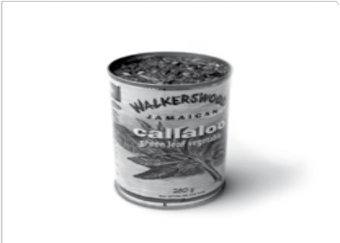
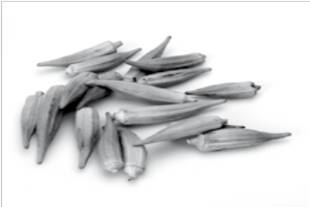
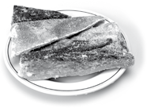



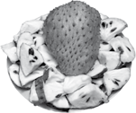
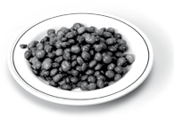
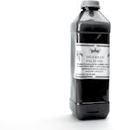
Classroom resources
Nutrition information plantation
Nutrition information supplementary
Nutrition information supplementary
Salt Fish (cod)
Typical composition | Per 100g
Energy | 1212Kj
Protein | 63g
Carbohydrate | 0g
Fat | 2.4g
Fibre | 0g
Vitamins Vit B1 (thiamin) | 0.27mg
Vit C | 3.5mg
Minerals Iron | 2.5mg
Callaloo (taro)
Okra
Typical composition Per 100g
Energy 177Kj
Protein 5g
Carbohydrate 10g
Fat 0.7g
Fibre 3.7g
Typical composition | Per 100g
Energy | 129Kj
Protein | 2g
Carbohydrate | 8g
Fat | 0.1g
Fibre | 3.2g
Vitamins Vit B1 (thiamin) | 0.2mg
Vit C | 21mg
Minerals Iron | 0.8mg
Vitamins
Vit B1 (thiamin)
0.2mg
Vit C
52mg
Minerals
Iron
2.3mg
Information from www.nal.usda.gov
Information from www.nal.usda.gov
Information from www.nal.usda.gov
Nutrition information supplementary
Nutrition information supplementary
Nutrition information supplementary
Soursop
Typical composition | Per 100g
Energy | 276Kj
Protein | 1g
Carbohydrate | 30g
Fat | 0.3g
Fibre | 3.3g
Vitamins Vit B1 (thiamin) | 0.07mg
Vit C | 21mg
Minerals Iron | 0.6mg
Pigeon peas
Red palm oil
Typical composition | Per 100g
Energy | 3607Kj
Protein | 0g
Carbohydrate | 0g
Fat | 100g
Fibre | 0g
Vitamins Vit B1 (thiamin) | 0mg
Vit C | 0mg
Minerals Iron | 0mg
Typical composition Per 100g
Energy 1435Kj
Protein 22g
Carbohydrate 63g
Fat 1.5g
Fibre 15g
Vitamins
Vit B1 (thiamin)
0.64mg
Vit C
0mg
Minerals
Iron
5.2mg
Information from www.nal.usda.gov
Information from www.nal.usda.gov
Information from www.nal.usda.gov

Slide 7
Classroom resources
Guideline daily amounts (GDAs)
 | Women | Men | Children (5-10 years)
Calories | 2,000Kcal | 2,500kcal | 1,800 Kcal
Protein | 45g | 55g | 24g
Carbohydrate | 230g | 300g | 220g
Sugars | 90g | 120g | 85g
Fat | 70g | 95g | 70g
Saturates | 20g | 30g | 20g
Fibre | 24g | 24g | 15g
Salt | 6g | 6g | 4g

Slide 8
Resource 5 – background information on diseases
Classroom resources
Kwashiorkor
Kwashiorkor is a disease caused through severe malnutrition, mainly affecting children.
It was first identified and described in the 1930s in Ghana. The word kwashiorkor comes from the Ga language, which is widely spoken in many parts of Ghana. It means ‘one who is physically displaced’, a reference to the fact that the disease often occurs in children who have just been weaned off of breast milk.
Protein deficiency is important but not the only cause of kwashiorkor. Breastfed children get a number of vital nutrients and amino acids through their mothers’ milk. As long as a mother is eating reasonably well, her child should stay healthy. Once a child is weaned new sources of these vital nutrients are needed. Unfortunately, many people in developing nations eat diets heavy in starch, without the protein and fresh fruits and vegetables they need.
Pellagra
Maize is rich in carbohydrate and several vitamins and minerals, but too much maize or sorghum leads to niacin deficiency (vitamin B3), which causes pellagra (known as the disease of the three ‘D’s – dermatitis, diarrhoea and dementia). Maize was a major part of the first people of the Americas’ diet, but they mixed it with ashes or lime when it was cooking which releases the niacin (see www.nhm.ac.uk/jdsml/nature-online/s
eeds-of-trade). Europeans and Africans without this knowledge suffered significantly from pellagra.
Beriberi
Too much cassava, dried or salted meat and fish prevent the uptake of thiamine (vitamin B1), which causes beriberi.
Thiamine is also easily destroyed by light and heat and when foods are soaked in water. When cassava is soaked and dried in the sun, the thiamine content is almost completely destroyed. The same happens when fish and meat are dried in the sun, salted and later soaked.
Beriberi was also common where people eat a lot of mill-polished rice, which removes all the thiamine.
Beriberi takes several forms and can cause weight loss, emotional disturbances, impaired senses, pain in the limbs, fever, irregular heart rate and swelling or oedema leading to severe mental illness before heart failure and death.
Scurvy
Scurvy is a disease resulting from a deficiency of vitamin C.
It leads to the formation of spots on the skin, spongy gums, and bleeding from the mucous membranes. It causes depression and an inability to move.
Scurvy was common among sailors, pirates and others on ships at sea longer than fruits and vegetables could be stored. Vitamin C is high in plants such as citrus fruits (oranges, lemons, limes, grapefruits), tomatoes, potatoes, cabbages, and green peppers.
Vitamins are also affected by different ways of cooking. Enslaved communities had little time or resources (especially fuel and pots) for cooking. One-pot cooking, with ingredients cooked slowly over a fire for hours while people were working, destroyed much of the vitamin content of vegetables and of the dried meat or fish.Fruit and vegetables that were eaten raw provided better nutrients.

