Slide 1
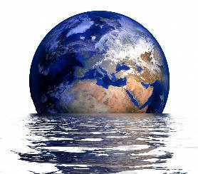
What is climate change
and why does it matter?

Slide 2
Contents
Slide 3: Introduction
Slides 4, 5 & 6: What are weather, climate and climate change?
Slides 7, 8 & 9: Causes of climate change
Slides 10, 11 & 12: How do we know climate is changing?
Slides 13, 14, 15 & 16: Effects of climate change
Slide 17: Climate Solutions: Wildlife Photographer of the Year video
Slides 18, 19, 20 & 21: The effects of climate change on us
Slide 22: Meet climate activists Mitzi Jonelle Tan and Clover Hogan: Our Broken Planet video
Slides 23, 24, 25, 26 & 27: How does climate change affect biodiversity?
Slides 28, 29 & 30: Is there any hope for the future?
Slide 31: When Youth Lead the Way: Live Talk with NHM Scientist video
Slides 32 & 33: Is there any hope for the future?
Slide 34: Useful links

Slide 3
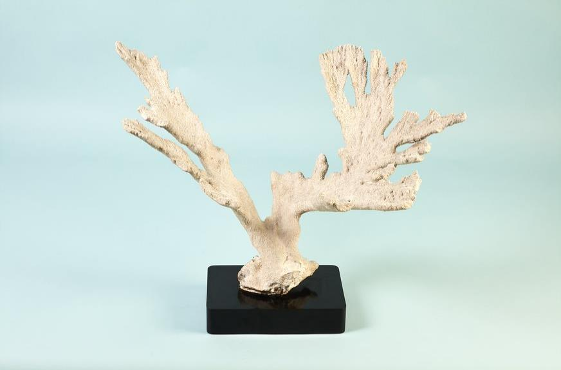
Climate change is the defining issue of our time. We have reached a pivotal moment in deciding our planet's future.
But what is climate change, why does it matter, and what could it mean for our collective future?
Bleached Elkhorn coral from the Our Broken Planet exhibition (2021)

Slide 4
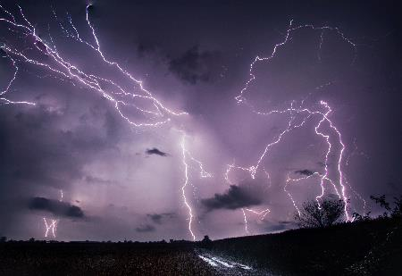
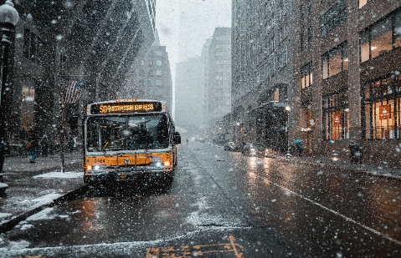
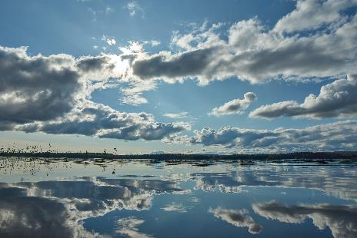
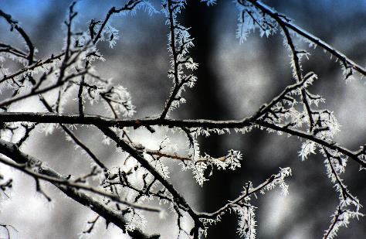
What are weather, climate and climate change?
Weather refers to atmospheric conditions, such as rain or snow, happening in a place at a specific moment in time.
Climate is how much, on average, a type of weather will occur over a longer period.

Slide 5
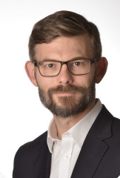
What are weather, climate and climate change?
Climate change is how the characteristics of the weather we experience in a certain place change.
It can get hotter or wetter on average or have more concentrated rain in a short period, but then get longer dry periods. All of that can be a result of climate change.
Dr Joeri Rogelj
Climate scientist
Imperial College London Grantham Institute

Slide 6
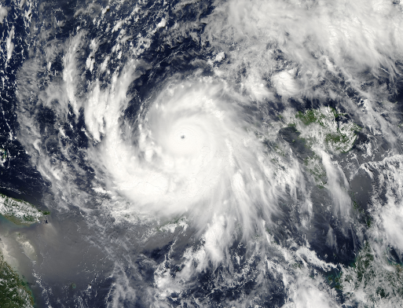
What are weather, climate and climate change?
Global warming is a term used interchangeably with climate change, although the latter is preferred because the warming atmosphere and oceans are just some of the effects we see.
Global warming is not just about temperature. In some cases, places are becoming wetter or drier. In other cases, we are seeing seasons moving. Furthermore, in some regions, we are seeing temperatures drop.
Notes:
Typhoon Utor, which affected the Philippines and China in 2013. It caused considerable damage and loss of life. Climate change influences most weather events, including tropical storms and hurricanes.
Image: NASA Goddard Space Flight Center via Flickr (CC BY 2.0)
It makes sense to use the term climate change as it encompasses all these changes.

Slide 7
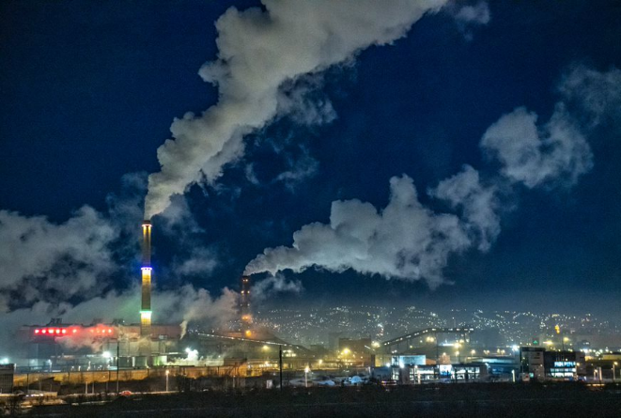
Causes of climate change
The main driver of current climate change is the emission of greenhouse gases, most importantly carbon dioxide and methane. These are primarily released when fossil fuels are burnt.
Greenhouse gases trap heat in our atmosphere. Since the mid-nineteenth century, the world has emitted over 2.2 trillion tonnes of carbon dioxide.
Emissions from coal-fired power plants contribute to the air pollution in Ulaanbaatar, Mongolia.
Notes:
Meat and dairy production, producing cement and some industrial processes, such as the production and use of fertilisers, also emit greenhouse gases.
Image: Asian Development Bank, via Flickr (CC BY 2.0)

Slide 8
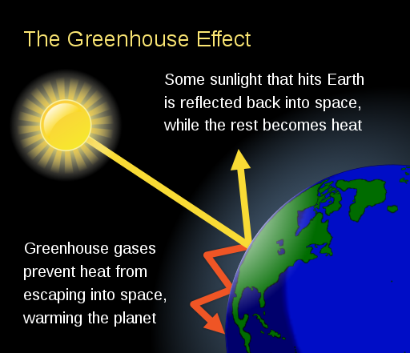
Causes of climate change
Notes:
Image: Wikimedia Commons (CC BY 2.0)

Slide 9
Causes of climate change
Energy from the Sun falls on our planet and normally gets reflected back as infrared radiation. But instead of escaping back out into space, this radiation gets absorbed by molecules of greenhouse gases, which then emit them in all directions. This process causes more heat to be kept near Earth's surface, warming our world.
Dr Joeri Rogelj
Climate scientist
Imperial College London Grantham Institute

Slide 10
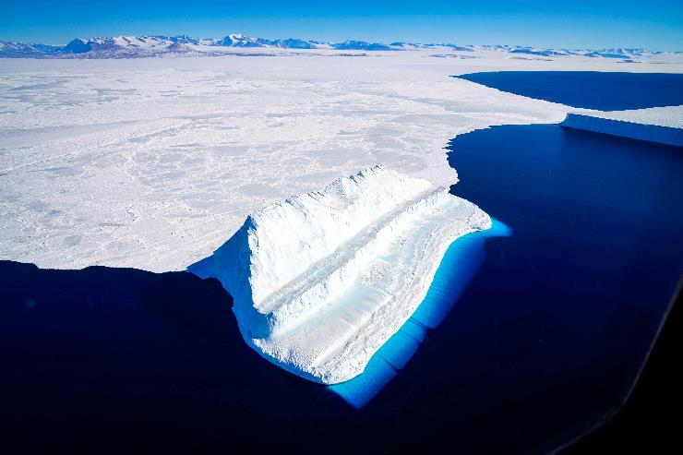
How do we know climate is changing?
There are measuring stations all around the world that keep track of air and sea temperature. From these measurements it's clear that temperatures are rising.
There are many indicators that tell us that the Earth is warming. For instance, it is clearly observed that polar ice caps and glaciers are melting.
Notes:
This image of an iceberg in McMurdo Sound was captured in 2017 as part of NASA's Operation IceBridge. This is an ongoing airborne mission to monitor changes in polar ice.
Image: NASA Goddard Space Flight Center via Flickr (CC BY 2.0)

Slide 11
How do we know climate is changing?
We know that greenhouse gases are causing change. Thanks to studies that look at how carbon dioxide absorbs infrared radiation, for example, there is a scientific understanding of how the planet would warm as a result of emissions.
This has allowed climate scientists to discount the theory that global warming is being caused by an increase in the Sun's intensity, for example.
It's also known that greenhouse gases are primarily emitted by fossil fuel combustion.
Notes:
In order to burn carbon and produce carbon dioxide, oxygen is required. The rate at which the amount of oxygen in the atmosphere is reducing demonstrates this is caused by combusting fossil fuels.

Slide 12
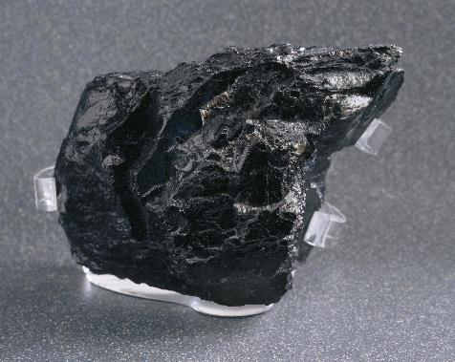
How do we know climate is changing?
There is additional evidence in the ratios of different types of carbon. Fossil fuels are, essentially, ancient plants. Plants now and in the past preferentially take up carbon-12. In normal conditions, the ratio between carbon-12 and carbon-13 is constant.
The ratio of carbon-13 in our atmosphere is going down at a rate that demonstrates the carbon dioxide increase is due to burning fossil fuels.
Notes:
320-290-million-year-old specimen from the Late Carboniferous period, Swansea, Wales. Coal is a sedimentary rock of organic origins and is a fossil fuel.

Slide 13
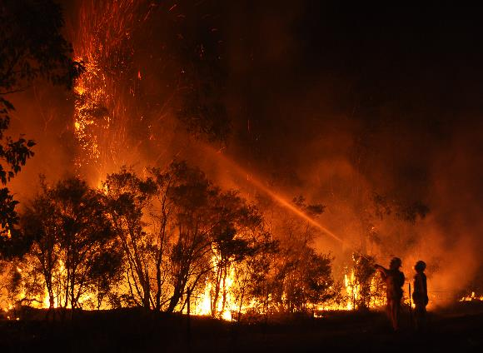
Effects of climate change
Climate change does not have the same effects everywhere. The planet is generally getting hotter, but some regions and seasons can at times be temporarily cooler. Some places will see drawn-out seasons, while others may experience concentrated bursts of extreme weather.
Extreme weather events - such as hurricanes, heatwaves, drought, wildfires and floods - are predicted to become more intense and frequent.
Notes:
Scientists predict that climate change will cause extreme weather events such as wildfires, floods and hurricanes to become worse.
Image: Quarrie Photography via Flickr (CC BY-NC-ND 2.0)

Slide 14
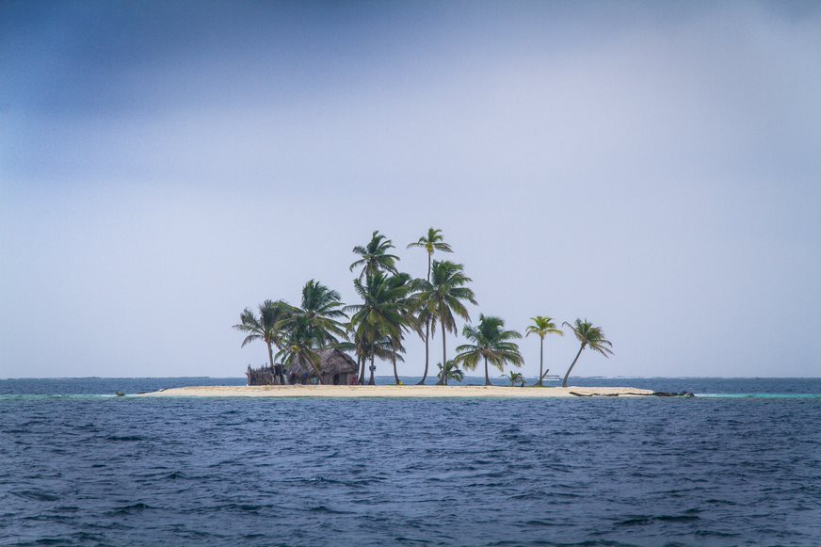
Effects of climate change
When the world warms, ice melts. Arctic sea ice could disappear entirely in a warming world, and Greenland and Antarctica's ice sheets could be destabilised. This would result in large sections melting, which would add more liquid to the ocean.
Sea level rise caused by climate change is a threat to low lying islands such as Panama's idyllic San Blas Islands, 49 of which are inhabited.
Notes:
Image: Marc Veraart via Flickr (CC BY-ND 2.0)

Slide 15
Effects of climate change
Pretty much any weather event is influenced by climate change. As scientists we can estimate how much climate change has made a certain event more likely or more intense than it would have been without climate change.
Dr Joeri Rogelj
Climate scientist
Imperial College London Grantham Institute

Slide 16
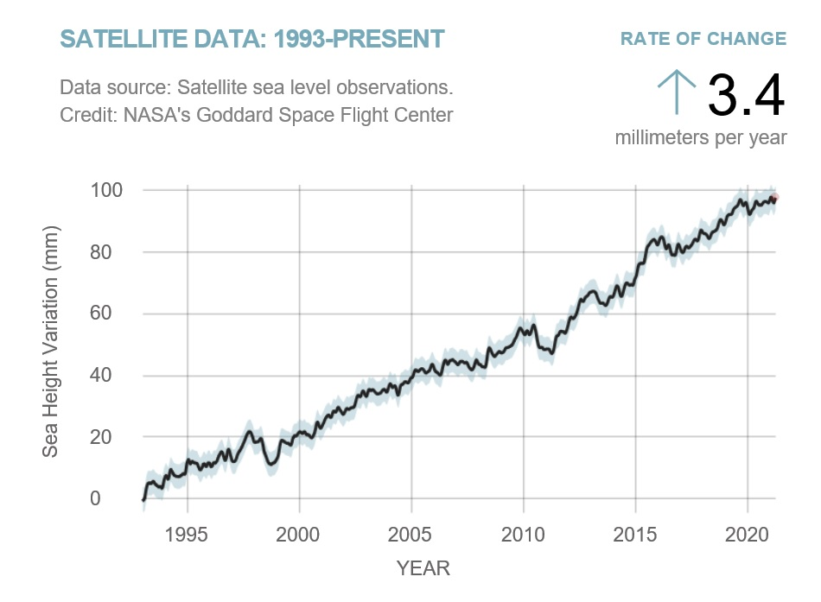
Effects of climate change
Ice also reflects the Sun's energy, so without ice, more heat is absorbed by the ocean. Water expands as it warms - this is known as thermal expansion. This effect means that the ocean takes up more space, causing sea levels to rise.
Satellite sea level observations from NASA's Goddard Space Flight Center (showing rise from 1993 – 2021)
Notes:
Even with rapid emission cuts, sea levels are expected to rise by around 26 to 53 centimetres by 2100. Along with melting ice sheets and glaciers, rising global temperatures could cause rainforests to die and widespread species extinctions.
Image: NASA via Wikimedia Commons (CC BY 2.0)

Slide 17
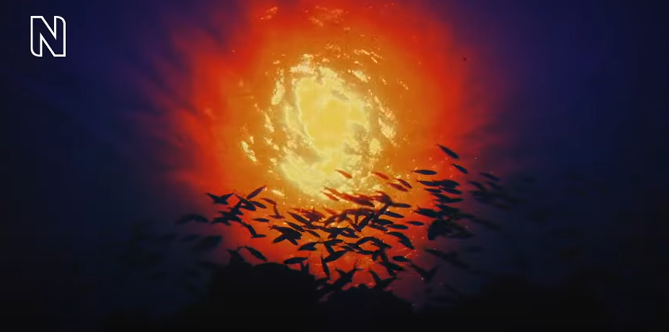
Climate Solutions: Wildlife Photographer of the Year video link:
https://www.youtube.com/watch?v=6y8Euo6YPGw
Notes:
We are living in a period of great change. Explore the threats facing our oceans and the world of potential solutions through the work of #WPY57 photographers David Doubilet and Jennifer Hayes who use the power of photography to tell the story of our oceans through time.

Slide 18
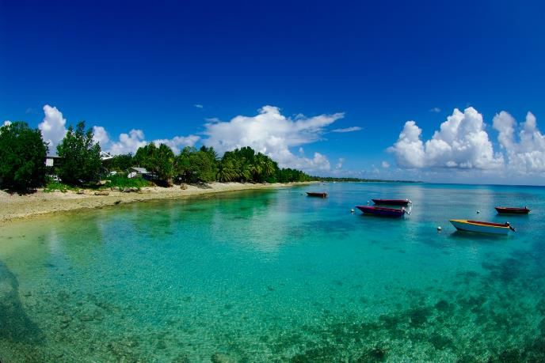
The effects of climate change on us
How climate change will affect you depends on who you are and where you live.
Around 190 million people currently live in areas that, due to rising sea levels, are expected to be under high tide levels by 2100. This could cause a massive displacement of populations. Low lying atoll nations such as Tuvalu and the Maldives are incredibly vulnerable to this change and could be lost to the sea.
Tuvalu - an island country in the Polynesian subregion of Oceania in the Pacific Ocean
Notes:
Hundreds of millions of people rely on seafood as their main source of protein. Warming and more acidic waters could destroy marine food chains by affecting their base, such as krill or coral reefs.
Image: Wikipedia Commons

Slide 19
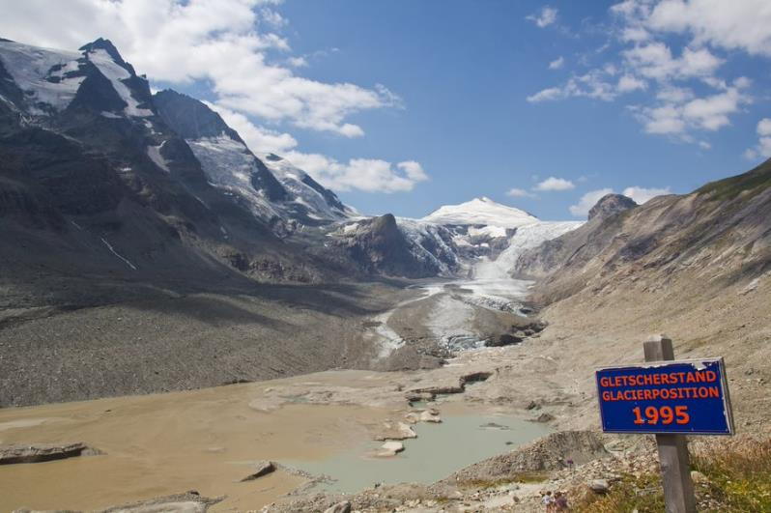
The effects of climate change on us
Longer-lasting drought could devastate crops, threating food security. Reservoirs drying up, as well as the loss of glaciers, could make drinking water scarce.
Increased precipitation can cause deadly flooding, as well as lowering indoor air quality. This could affect our health as dampness benefits moulds and fungi.
Pasterze Glacier is estimated to be receding at a rate of 10 metres per year. A sign shows where the glacier lay in 1995, with the ice having since dramatically retreated up the valley.
Notes:
Image: H Raab via Flickr (CC BY-NC-ND 2.0)

Slide 20
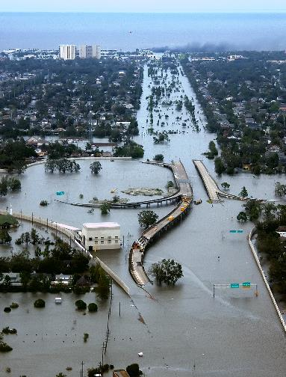
The effects of climate change on us
Around four billion people live in urban areas, and by 2050 this will have risen to an estimated 6.7 billion.
City dwellers are not exempt from climate change's effects. Urban populations usually rely on rural areas for inputs such as food and water. If climate change disrupts these important connections, it could heavily affect those in urban areas.
New Orleans, Louisiana in the aftermath of Hurricane Katrina.
Notes:
Image: AP Photo/U.S. Coast Guard via Wikimedia Commons (CC BY 2.0)

Slide 21
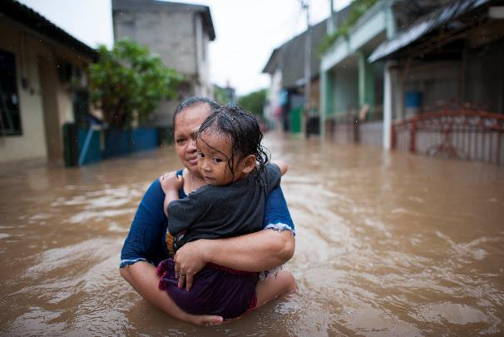
The effects of climate change on us
Natural disasters impact poor and vulnerable populations disproportionately hard and clearly expose the consequences of ignoring social inequalities. With extreme weather increasing, these populations face a heightened level of risk.
For example, the urban heat island effect amplifies the effects of temperature extremes in cities. Those unable to afford to buy and run air conditioning may find their health compromised.
Notes:
Differences in wealth, ethnicity and health are just some of the inequalities that could determine a person's vulnerability to the effects of climate change
Image: Kompas/Hendra A Setyawan via World Meteorological Organization Flickr (CC BY-NC-ND 2.0)

Slide 22
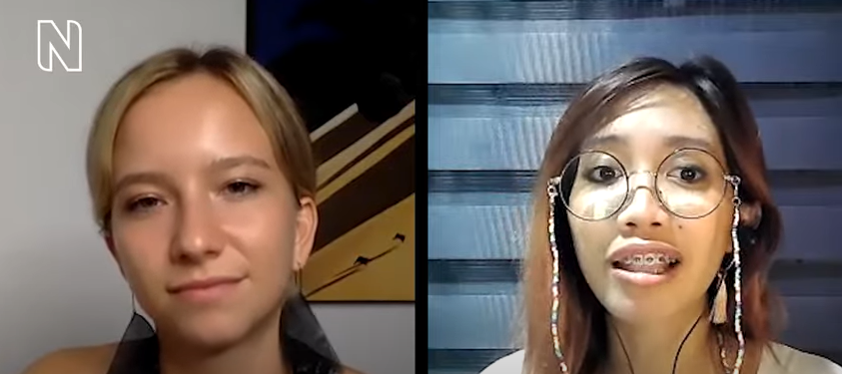
Meet climate activists Mitzi Jonelle Tan and Clover Hogan: Our Broken Planet video link:
https://www.youtube.com/watch?v=rzEvLTiaJZk
Notes:
Climate activists Mitzi Jonelle Tan and Clover Hogan discuss their personal experiences of climate change impacting their homes and communities, and the action they have been inspired to take.

Slide 23
How does climate change affect biodiversity?
The natural world is delicately balanced. No species - including ours - is completely independent of all others. A 2019 report confirmed that over one million animal and plant species are now at risk of extinction as a result of human activities.
In the UK, an analysis of over 700 species has shown that more than 80% of trends between 1976 and 2005 indicate seasonal events are happening earlier.
Differing rates of change could mean that species' lives are no longer synchronised with those they rely on.

Slide 24
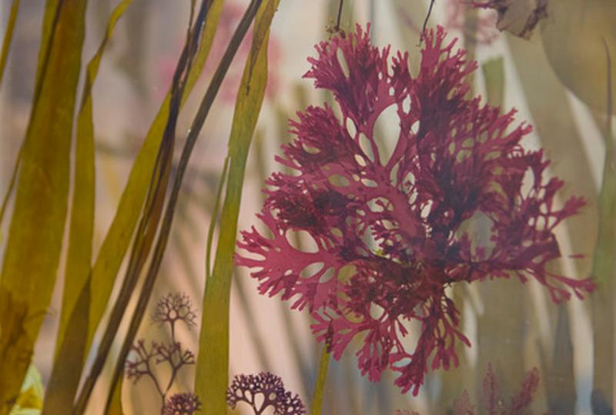
How does climate change affect biodiversity?
Many plants are flowering earlier. Migrating birds arrive earlier, leave later and some even are getting smaller. Butterflies are emerging earlier. Birds and amphibians are laying their eggs earlier in the year. Some species are moving into new areas, such as kelps which form vital marine habitats.
Seaweeds are important for many reasons. They act as vital habitats. Some also help protect coastlines from erosion.

Slide 25
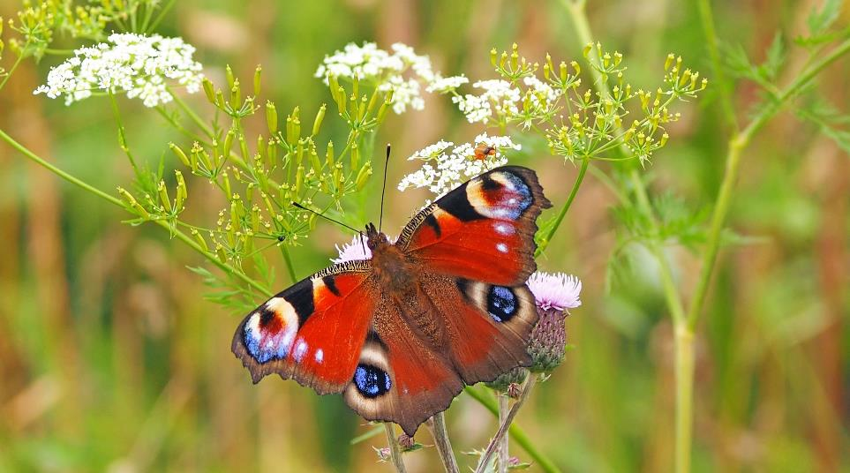
How does climate change affect biodiversity?
Insects are one of the most vulnerable groups, with less ability than mammals or birds to escape warmer temperatures. Loss of insects, which are a primary food source for many animals, a key pollinator of plants and whose numbers are already plummeting, could cause the ecosystem to collapse.
All indications suggest that insect populations are in decline worldwide, including over 50% of all butterflies.

Slide 26
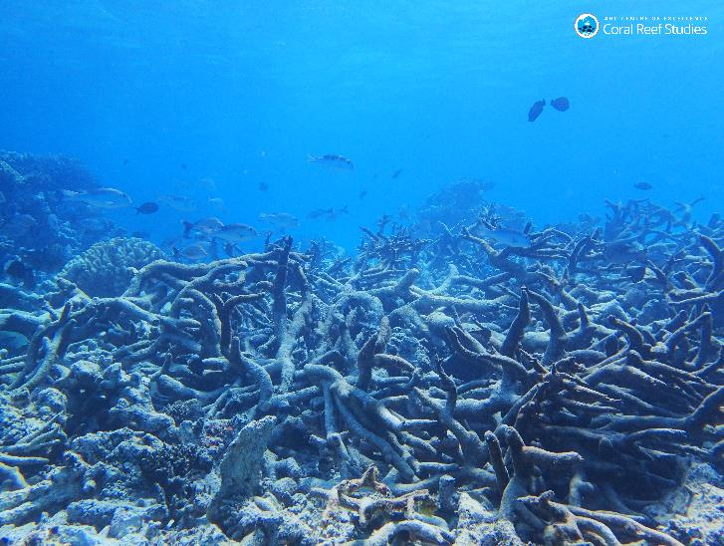
How does climate change affect biodiversity?
In aquatic ecosystems, activities to mitigate the side effects of climate change, such as building hard flood defences, can have negative effects. As sea levels rise, sea walls reduce the space for intertidal ecosystems. A rising sea could also damage important coastal habitats like sand dunes and cliffs.
Graveyard of Staghorn coral, Yonge Ref, Northern Great Barrier Reef
Notes:
The ocean may look homogenous, but it can also experience changes. One example of this, is ocean heatwaves, where if a particularly warm mass of water comes to an area like coral reefs, it induces loss and mass dieback.
Image: ARC Centre of Excellence for Coral Reef Studies via Flickr (CC BY 2.0)

Slide 27
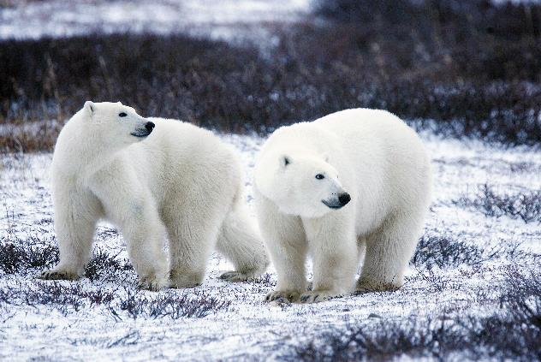
How does climate change affect biodiversity?
The loss of Arctic sea ice takes away a key habitat from animals including polar bears, seals and walruses. The ice is now declining at a rate of more than 12% per decade.
Climate change is just one of the stressors currently impacting nature. Sea use, invasive species, pollution and the exploitation of organisms are all factors in the threat to nature.
Notes:
A warming planet and melting ice threatens the survival of iconic animals such as polar bears. Without drastic changes, it's expected that there will be devastating changes in biodiversity and ecosystems.
Image: Gary Kramer/USFWS via U.S. Fish and Wildlife Service Flickr (CC BY 2.0)

Slide 28
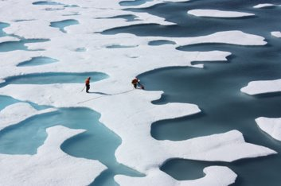
Is there any hope for the future?
Climate change has been a known problem for around 30 years. Starting to fix it earlier might have made this daunting task much easier.
Over the past decades, scientists have estimated the potential impacts of the planet's average temperature rising by different amounts. Governments have decided to pursue efforts to make sure the global increase in temperature does not exceed 2°C, and is as close as possible to 1.5°C.
By understanding more about the planet, such as by studying the poles, scientists are able to estimate the consequences climate change will have.
Notes:
The difference in outcomes between 1.5 and 2°C are considerable. The impacts are the difference of 70% or 99% of coral reefs dying or a summer free of Arctic sea ice once every 100 or 10 years.
Image: NASA Goddard Space Flight Center via Flickr (CC BY 2.0)

Slide 29
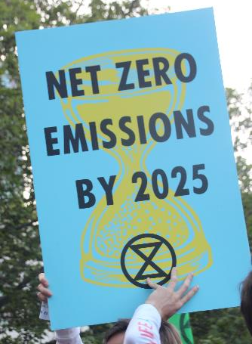
Is there any hope for the future?
Scientists have determined how much carbon dioxide can still be emitted before this temperature rise limit will be exceeded. This is called the carbon budget and it's relatively small.
Globally, we are currently emitting around 42 billion tonnes of carbon dioxide a year. In order to reach net-zero emissions, scientists are using engineering and economic models to understand how we can transform society to stay within the limit.
Placard from a 2019 climate change march in Melbourne, Australia
Notes:
Image: John Englart via Flickr (CC BY 2.0)

Slide 30
Is there any hope for the future?
We definitely know how to reduce emissions to a significant degree. We are seeing more impacts of climate change, but we can also see a heightened interest and concern in the general public. Ultimately, reducing emissions is really an issue of public and political will.
Dr Joeri Rogelj
Climate scientist
Imperial College London Grantham Institute

Slide 31
When Youth Lead the Way: Live Talk with NHM Scientist video link:
https://www.youtube.com/watch?v=rGcMQBwBJHA
Notes:
A live stream event where a panel of Millennials and Generation Z discuss some of the core issues at the heart of the planetary emergency in their fight to protect the future of our planet.
The voices of young people are elevated as they share how they have been impacted in their own lives, revealing what motivates them to stand up and take action, and what they would do to save the planet.

Slide 32
Is there any hope for the future?
The transformation of society could include changes such as increasing the share of energy produced by renewables, changing the way food is produced, changing our diets to have a lower carbon footprint and changing the way we build houses and design cities.
Moving to net-zero emissions will not be a perfectly co-ordinated transition. It will take some countries to lead and show the world that moving to this new way of living and functioning is both possible and beneficial for other sustainability objectives, such as public health and food security.

Slide 33
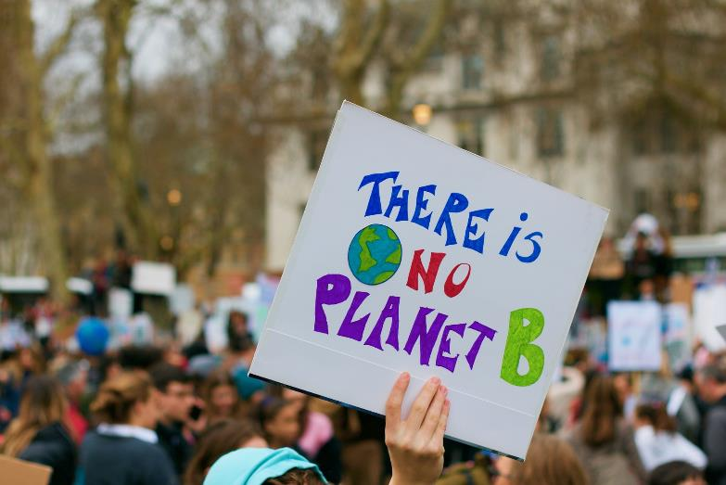
Is there any hope for the future?
Recent pledges made at COP 26 seem to have kept the 1.5°C goal in sight, but action is certainly needed to avoid the worst impacts from the climate crisis.

Slide 34
Useful links
http://www.nhm.ac.uk/discover/what-you-can-do-to-help-the-planet.html
http://www.nhm.ac.uk/discover/what-is-the-anthropocene.html
https://www.nhm.ac.uk/discover/news/2020/january/we-are-declaring-a-planetary-emergency.html
https://www.nhm.ac.uk/discover/news/2019/may/one-million-animals-and-plants-face-extinction.html
https://www.nhm.ac.uk/our-science/our-work/biodiversity.html
https://www.nhm.ac.uk/visit/our-broken-planet.html

