Slide 1
What is biodiversity?

Slide 2
Contents
Slide 3: What is Biodiversity? video
Slide 4: How fish scales make your make-up shimmer: The life behind video
Slide 5: How piranha poop helps make your trainers: The life behind video
Slide 6: How flies help make your chocolate ice cream: The life behind video
Slide 7: Discover Biodiversity: Do your bit for nature
Slide 8: What is biodiversity?
Slide 9: Why do we need biodiversity?
Slide 10: Ecosystem services
Slide 11: Biodiversity and species richness
Slides 12 & 13: Endangered species and mass extinction
Slides 14 & 15: Causes of biodiversity loss
Slides 16 & 17: Biodiversity and invasive species
Slides 18 & 19: Protecting the natural world
Slide 20: Useful links

Slide 3
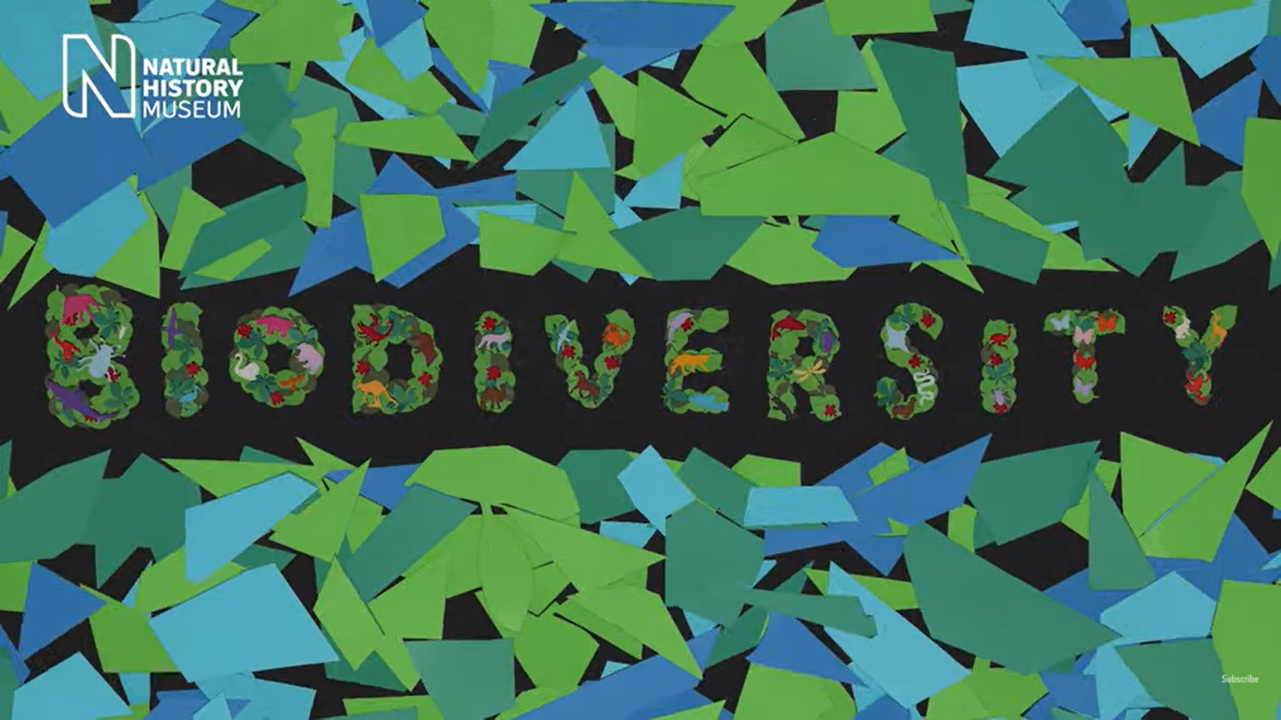
What is Biodiversity? video link:
https://www.youtube.com/watch?v=XTC4qiXd36Q
Notes:
Biodiversity is the name we give to the variety and amount of all life on Earth. All living things exist within their own communities, or ecosystems - oceans, forests, deserts, ice caps and even cities. All this put together is biodiversity: the volume of life on Earth as well as how different species interact with each other and with the physical world around them.

Slide 4
How fish scales make your make-up shimmer: The life behind video link:
https://www.youtube.com/watch?v=9pDYG5_SPCs
Notes:
Did you know that it's fish scales that make some make-up shimmer? Tree-climbing goats also play a special role in the production of some hair care products! We all rely on biodiversity, which is the incredible variety of life on our planet. Without it, we wouldn't have many of the things we love and use every day, such as cosmetics. Explore more about biodiversity and why it's important that we do all we can to protect it.

Slide 5
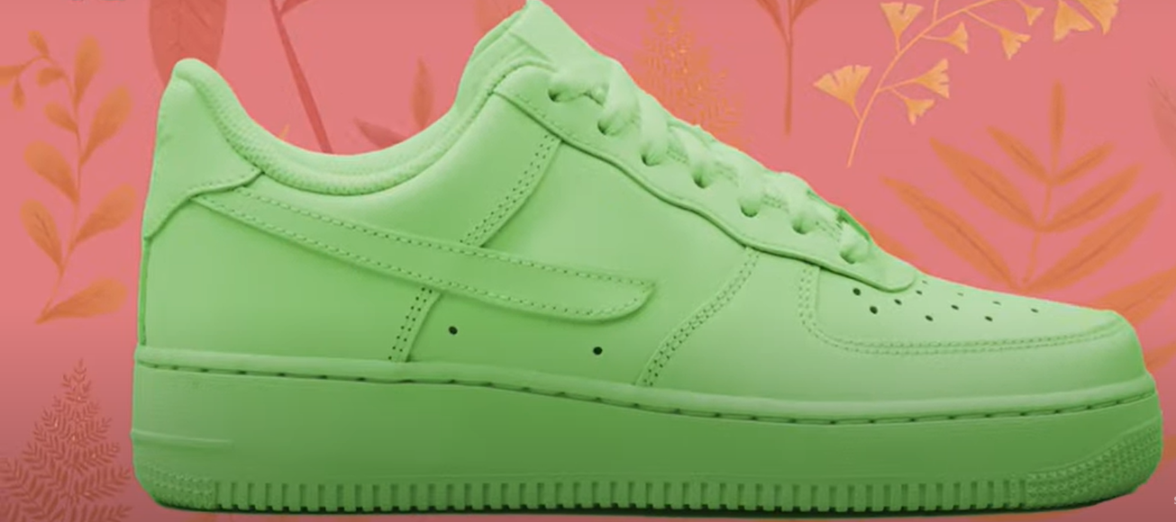
How piranha poop helps make your trainers: The life behind video link:
https://www.youtube.com/watch?v=fRqJfHr6-bU
Notes:
What do pineapples, piranhas and poisonous beans have to do with your favourite footwear? We all rely on biodiversity, which is the incredible variety of life on our planet. Without it, we wouldn't have many of the things we love and use every day, such as trainers! Explore more about biodiversity and why it's important that we do all we can to protect it.

Slide 6
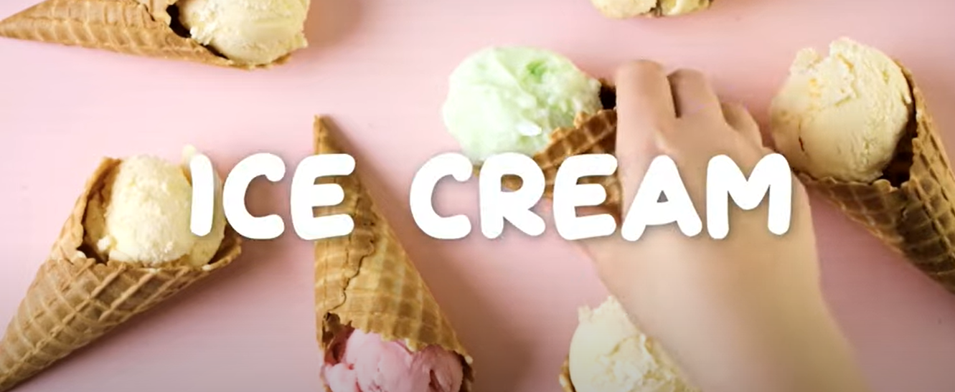
How flies help make your chocolate ice cream: The life behind video link:
https://www.youtube.com/watch?v=MCjoOc54pHs
Notes:
If you're a fan of chocolate ice cream, did you know that you have seaweed and tiny flies to thank for it? This chilly treat wouldn't be the same without them. We all rely on biodiversity, which is the incredible variety of life on our planet. Without it, we wouldn't have many of the things we love, such as ice cream! Explore more about biodiversity and why it's important that we do all we can to protect it.

Slide 7
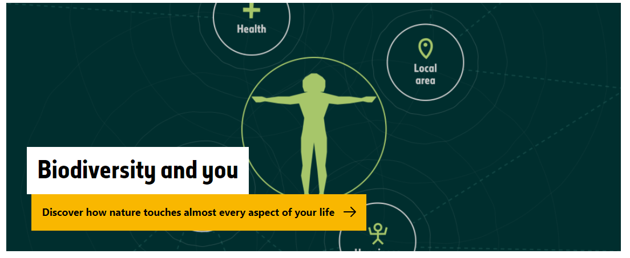
Discover Biodiversity: Do your bit for nature link:
https://www.nhm.ac.uk/discover/biodiversity/act

Slide 8
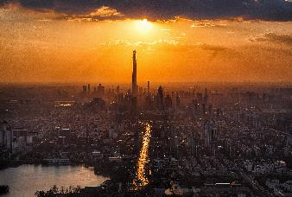
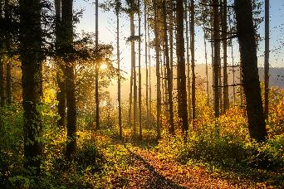
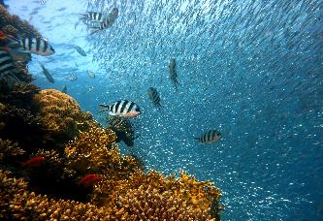
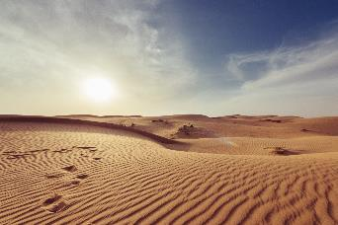
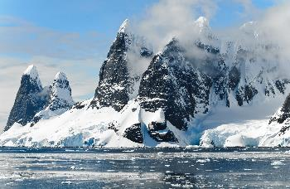
Biodiversity is the name we give to the variety of all life on Earth. Bacteria to baboons, plants to people - the range of life on our planet is incredible.
All living things exist within their own communities, or ecosystems - oceans, forests, deserts, ice caps and even cities.
All this put together is biodiversity: the volume of life on Earth as well as how different species interact with each other and with the physical world around them.
Notes:
The word biodiversity is a contraction of 'biological diversity'. The concept is broad and complex, but that complexity is what makes Earth a perfect place for humans to live.

Slide 9
Why do we need biodiversity?
Humans rely on biodiversity to survive. We are intertwined in a big natural system, and each element supports and enables all of us to thrive.
It is easy to see why humans need nature: we need fresh water, clean air, and plants and animals for food. But what we need specifically is biodiversity. Having nature around us isn't enough - we need a natural world that is complex, resilient, thriving and full of variety.
Notes:
Nature needs to be able to cope with change. Different animals and plants in a habitat help to make that place stable and sustainable. Small changes will have fewer effects, allowing it to keep providing us with what we need.

Slide 10
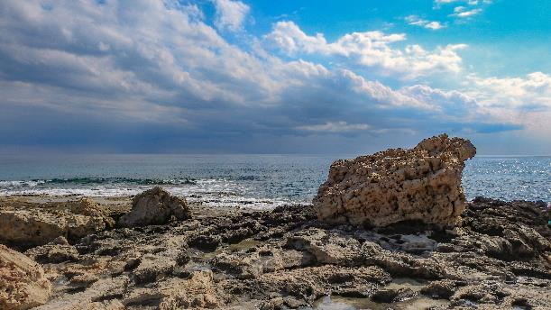
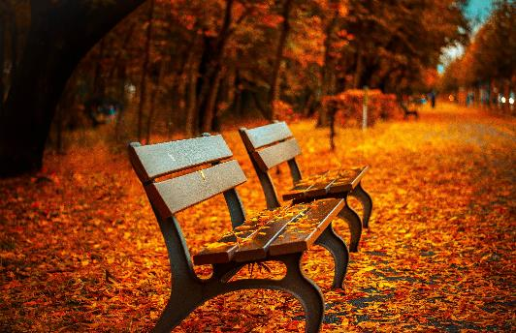
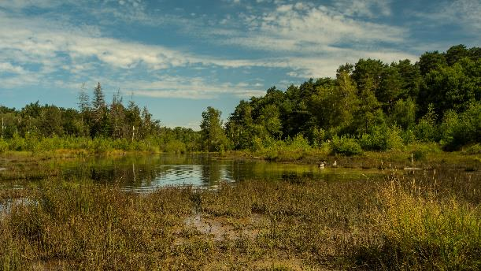
Ecosystem services
The benefits biodiversity brings are called ecosystem services. Biodiversity keeps us all alive, but it also helps to make our lives healthy and safe.
Ecosystem services include forests that diminish floods, coastlines that protect us from changing sea levels, wetlands that regulate pollution and parks that ease our anxiety.

Slide 11
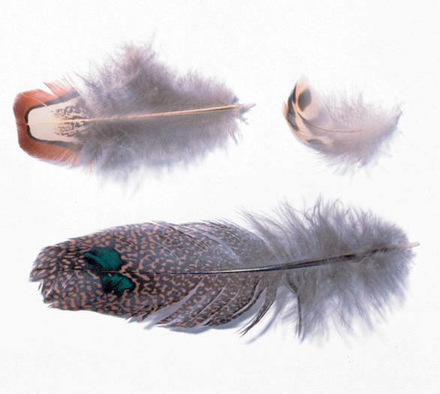
Biodiversity and species richness
When we talk about biodiversity, we often talk about species richness as well. Species richness is the number of different species in an area, a way of measuring biodiversity.
Studying species richness helps us to understand the differences between places and areas.
Contour feathers and tail coverts from several species of birds. These specimens are held in the Museum collection.
Notes:
For example, the Amazon rainforest very species-rich as it is home to over 10 million different species. In contrast, the Sahara Desert is far less rich, with just a few thousand species. About 1.5 million species have been described by scientists, and most of them are insects. But it is thought that there are millions more sharing our planet with us.

Slide 12
Endangered species and mass extinction
Overall biodiversity loss can speed up extinction. More and more animals and plants are facing an uncertain future.
Currently, more than 30,000 species are listed as threatened with extinction, which is 27% of all assessed species.
We know that millions of species have already gone extinct over the long history of planet Earth. Biodiversity rates have always ebbed and flowed. In fact, at least 99% of all the organisms that have ever lived are now extinct.
Notes:
The International Union for Conservation of Nature (IUCN) is the global authority on the status of the natural world. It keeps a Red List of endangered species, an important indicator of the health of the world's biodiversity.
Researchers agree that five huge mass extinction events have already happened, including the one that wiped out the dinosaurs 66 million years ago.

Slide 13
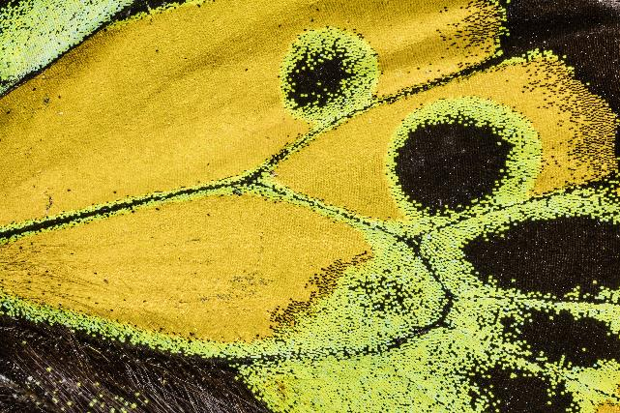
Endangered species and mass extinction
However, extinction rates have been accelerating as human populations continue to grow, and many scientists argue we are living through a sixth mass extinction. This time, humans rather than natural events are to blame.
A sample from the wing of a Rothschild's birdwing, a large butterfly from Papua New Guinea.
Notes:
Species diversity in more than half of land ecosystems is now critically low. A 20% drop is widely considered the threshold at which biodiversity's contribution to ecosystem services is compromised. It's estimated that over a quarter of Earth's land surface has already exceeded this.
The Rothschild's birdwing is Near Threatened on the IUCN Red List, a resource which helps us track biodiversity levels.

Slide 14
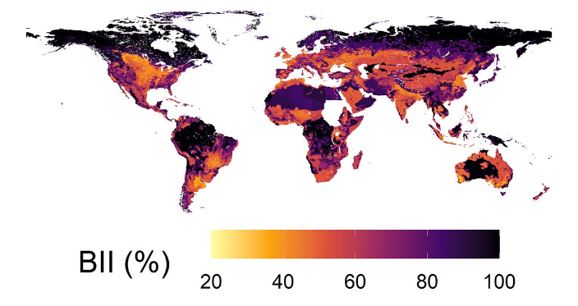
Causes of biodiversity loss
Biodiversity is in trouble in the UK and across the globe, and its loss can refer to local and worldwide extinctions. Species and ecosystems can be fragile, so small changes can have large consequences.
The causes of biodiversity loss are complicated, but we know the human population is making the problems worse.
The Biodiversity Intactness Index (BII) estimates how much of an area’s natural biodiversity remains. It helps us understand past, current and future biodiversity changes. Find out more about the Global Biodiversity Intactness Index here.
Notes:
In the short time humans have been on the planet we have increasingly disrupted the balance of biodiversity through changing land use, overexploitation of resources and the impact we are having on climate.
We are converting natural habitats into farms, factories, roads and cities. In the ocean, we are overfishing, drilling and mining.

Slide 15
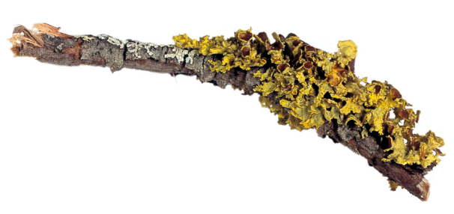
Causes of biodiversity loss
Cities and towns have a smoothing effect on biodiversity, tending to favour generalist species like feral pigeons. Those that require a particular habitat, or are intolerant of disturbance or pollution, often can't survive. This is called biotic homogenization.
Animals and plants that can only live in one small area of land - like unique butterflies or flowers - can go locally extinct if the city's conditions are unfavorable to them.
A lichen specimen held in the crypt herbarium at the Museum.
Notes:
All living things, including plants and fungi, are represented by the word 'biodiversity'.

Slide 16
Biodiversity and invasive species
Animals and plants moving around the world are also big threats to biodiversity. When a new, non-native species arrives in a new area, it is often called an alien species. Mostly this movement doesn't cause a problem. However, if that species causes harm to wildlife or humans, it is called an invasive alien species.
Invasive species are often introduced through human activity, either deliberately or accidentally.
Notes:
One example is rabbits in Australia, which were brought to Australia by human colonisers in the eighteenth century to be bred for food. Their population soon exploded and quickly caused devastation because of the huge amount of plants they ate.
Even now, rabbits in Australia can kill young orchards and cause serious erosion problems by eating trees and native plants.

Slide 17
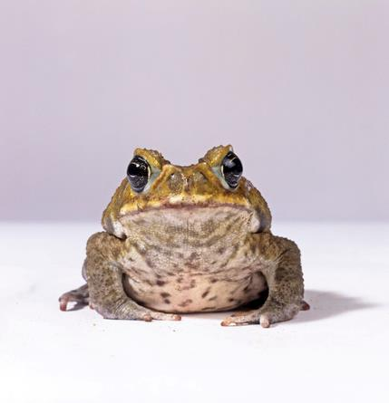
Biodiversity and invasive species
This story is echoed all over the world. It is an especially big problem on islands, where wildlife has evolved in isolation over millions of years, and the ecosystem can be more vulnerable to the introduction of new animals and plants.
Invasive species can reduce biodiversity and species richness, cause extinctions and dramatically change ecosystems.
Cane toads are an invasive species and a common sight in northern Australia after being deliberately introduced in the early twentieth century.

Slide 18
Protecting the natural world
Every species matters, and the Museum is doing its bit to fight for biodiversity. Our scientists represent one of the largest groups in the world working on natural diversity and are at the forefront of digital, analytical and genomic technologies to expand our knowledge of nature.
Projects underway at the Museum are creating datasets that help us to understand ecosystem dynamics and changing patterns of biodiversity.
Notes:
The scientific research collections are crucial to managing the unprecedented period of environmental change we're currently experiencing. They provide global information on 4.5 billion years of natural history on our planet and the last 300 years of environmental change.

Slide 19
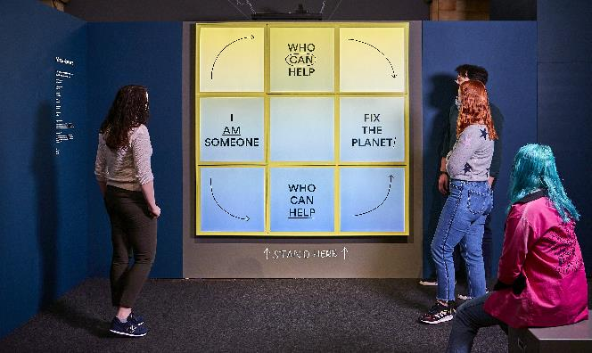
Protecting the natural world
Our future rests on a biodiverse Earth, so we can no longer take it for granted. We are now in an era when humans have a huge impact on the planet's natural systems. Biodiversity loss is just as catastrophic as climate change, but the solutions are linked.
Stopping further damage to the planet requires big change, but we can do it if we act now, together.
Our Broken Planet exhibition (2021)

Slide 20
Useful links
https://www.nhm.ac.uk/our-science/our-work/biodiversity.html
https://www.nhm.ac.uk/visit/our-broken-planet.html
https://www.nhm.ac.uk/our-science/data/biodiversity-indicators.html
https://www.nhm.ac.uk/take-part/centre-for-uk-biodiversity.html
https://www.nhm.ac.uk/discover/news/2019/october/the-state-of-nature-41-percent-of-the-uks-species-have-declined.html
https://www.nhm.ac.uk/discover/news/2019/february/the-world-s-insect-populations-are-plummeting-everywhere-we-look.html

