Slide 1
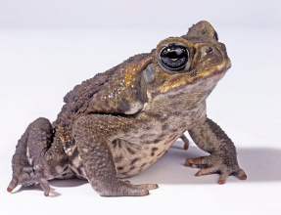
What are invasive species?

Slide 2
Contents
Slide 3: Introduction
Slide 4: What are native, non-native and introduced species?
Slides 5 & 6: Why are invasive species a problem?
Slides 7, 8, 9 & 10: How do invasive species spread?
Slides 11 & 12: Example: cane toads (Bufo marinus)
Slides 13, 14 & 15: UK invasive species
Slides 16, 17, 18 & 19: Example: grey squirrels (Sciurus carolinensis)
Slides 20, 21, 22 & 23: Invasive species and climate change
Slides 24, 25, 26 & 27: What can we do about invasive species?
Slides 28, 29 & 30: What you can do to help
Slide 31: Nature on Your Doorstep video
Slide 32: What you can do to help
Slide 33: Community Science
Slide 34: Urban Nature Project video
Slide 35: Useful links

Slide 3
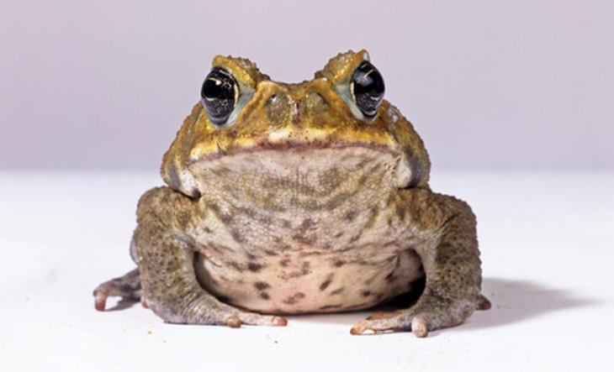
An invasive species is an animal or plant that harms an environment after being introduced to it by humans. In some places, invasive species have changed the natural world beyond recognition.
How do animal and plants move around the planet? And what happens when they come into conflict with other organisms?
Notes:
Cane toads are an invasive species and a common sight in northern Australia after being deliberately introduced in the early twentieth century.

Slide 4
What are native, non-native and introduced species?
Native species are species that have become part of an ecosystem through natural processes.
Non-native species or introduced species are species found outside their normal range because of human activity. Not all of these are invasive. Many of these can thrive in new areas and pose no threat others.
Invasive species are species outside their normal ranges that have a negative impact on other organisms or environments.
Notes:
Invasive species tend to have escaped controlling species (which might be predators, herbivores or parasites) in their normal ranges, which would have otherwise limited their survival, and they are often well suited to their new environment.

Slide 5
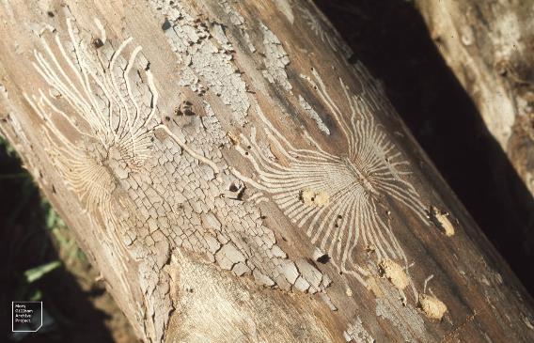
Why are invasive species a problem?
Invasive species can do all sorts of damage to an existing ecosystem, including changing habitats and starving native animals of food and resources.
They may eat or parasitise native species, which sometimes have no defences against them. They can also outcompete native species for food, light or nesting sites. Sometimes they even bring new diseases with them. Often, an introduced species can breed very quickly - if left unchecked they dominate habitats and smother native wildlife.
Notes:
Dutch elm disease (caused by the fungus Ophiostoma ulmi) is spread by elm bark beetles who bore through the bark. It has killed millions of elm trees in the UK over the last 40 years.
Image: Mary Gillham Archive Project via Flickr (CC BY 2.0)

Slide 6
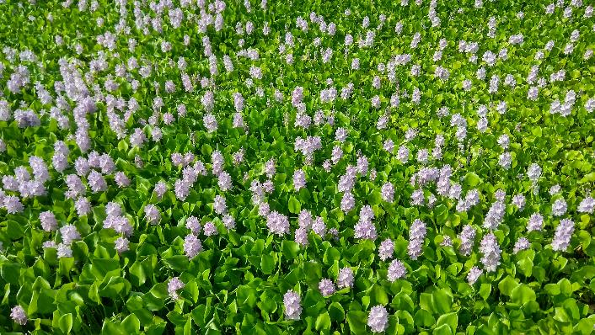
Why are invasive species a problem?
Invasive species are a much bigger threat to nature than many people realise. Species invasions are one of the biggest causes of ecosystem change, and there are so many of them that some ecosystems are facing a big struggle to survive.
Invasive species can cause chaos in a finely balanced habitat. They are an even bigger threat to biodiversity than climate change, and they can also have a large economic impact on the areas they take over.
Notes:
Introduced to the United States from South America, Water hyacinth looks like a beautiful aquatic plant. When growing in the wild, it blocks sunlight and crowds out submerged plants and organisms in the water. It can also clog waterways and pipes.
Image from Wikimedia Commons (CC BY 2.0)

Slide 7
How do invasive species spread?
Human activities are the biggest cause of the spread of invasive species.
Sometimes humans move animals and plants around the world deliberately, for example to change an environment, as a form of pest control, to hunt, as horticultural specimens or to keep as pets.
This can go very wrong if those animals and plants move into wild settings and start breeding or begin behaving in ways that humans did not predict.

Slide 8
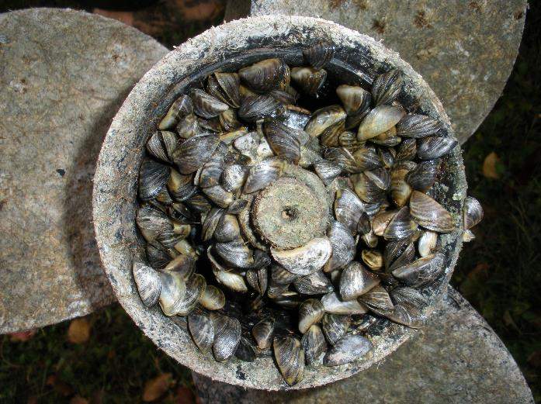
How do invasive species spread?
Humans can also create a problem by accident. Over the last century, we've been flying to holiday destinations and shipping cargo to far-flung countries, and occasionally animals and plants have hitched a ride.
Notes:
A boat propeller covered in Zebra mussels, a type of small freshwater mussel originally native to the lakes of southern Russia and Ukraine. It has become an invasive species in various countries worldwide, having been accidentally introduced.
Image: Tom Britt via Flickr (CC BY 2.0)

Slide 9
How do invasive species spread?
Chris Raper is based at the Natural History Museum and manages the UK Species Inventory, a database containing the names of all known organisms in the UK. He is often one of the first people to be made aware of a new species as it arrives on UK shores.
Human interaction with animals and plants can be complicated. Humans often don't move animals deliberately, but through industry or transport. Or species were moved to neighbouring regions and then spread of their own accord.

Slide 10
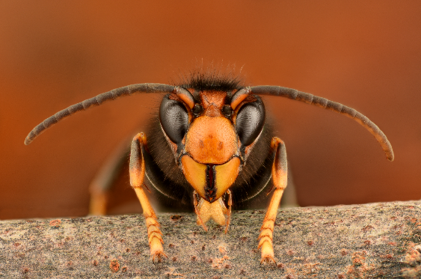
How do invasive species spread?
For instance, the Asian hornet (Vespa velutina) wasn't brought to the UK, but rather to Europe on wooden pallets from China, then spread to the UK itself. That's still classed as a non-native invasive species.​ Similarly, marine species often wash up on our shores on man-made objects, which float much further than natural substances.
They are also non-native species.
Chris Raper
UK Species Inventory Manager
Natural History Museum
Notes:
A male Asian hornet (Vespa velutina). These insects are specialised honeybee predators. Female workers or queens are more commonly seen than males.
Image: Gilles San Martin via Flickr (CC BY-SA 2.0)

Slide 11
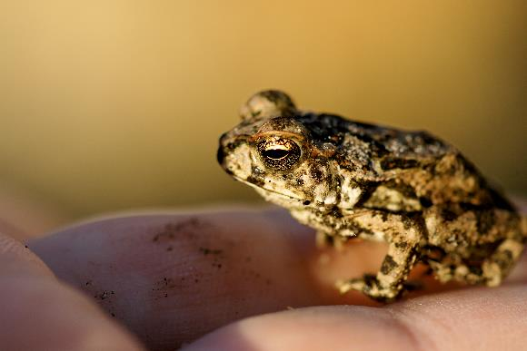
Example: cane toads (Bufo marinus)
Cane toads were deliberately introduced to Australia from Hawaii in 1935 as a form of biological control. It was hoped that the toads would eat the grey-backed cane beetles that were destroying sugar cane plantations.
At first, just a handful of toads were released by scientists into Queensland, but this number soon grew as others followed suit. Within two years, 62,000 toadlets had been released into the wild.
Notes:
A juvenile Cane toad
Image: Mr Clean via Flickr (CC BY-SA 2.0)

Slide 12
Example: cane toads (Bufo marinus)
The venomous, warty toads, native to South and Central America, did nothing to protect the plantations, but they did reproduce. Now they can be found all over the northern half of Australia.
Cane toads have had a big impact on Australian ecosystems. They are venomous at every stage of their life cycle, so they can kill predators when they are eaten. Some smaller predator species have learned to avoid eating the toads, but others have been worse affected.
Notes:
Native Australian frogs are eaten by the toads and must compete with them for food, but these negative impacts have been balanced by positive ones. The native frogs now face fewer large predators thanks to the toads. This is one example of how invasive species can change an ecosystem in complex ways.

Slide 13
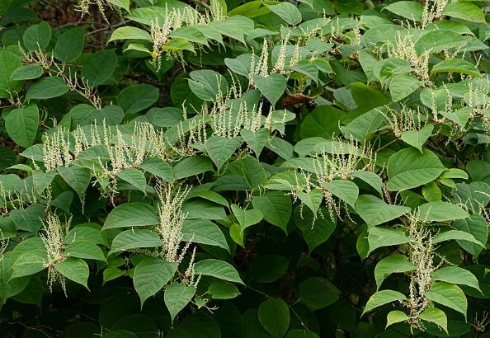
UK invasive species
Britain is home to more than 3,000 invasive species, including some that have become commonplace, including grey squirrels, muntjac deer, American bullfrogs and American mink.
Plants can be invasive, too. Japanese knotweed has caused havoc in some areas of the UK. It is native to east Asia but was brought to the UK by the Victorians as an ornamental plant. Now it can be found all over the country and can be hard to control.
Notes:
Japanese knotweed can choke native plants.
Image: Wikimedia Commons (CC BY 2.0)

Slide 14
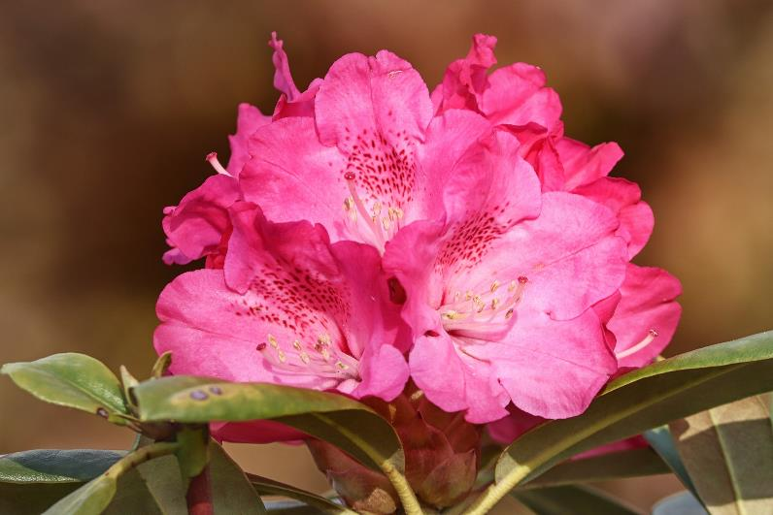
UK invasive species
Rhododendrons are a common site in woodlands and gardens, and you'd be forgiven for thinking they are a native plant. They were actually introduced in 1763 and are considered to be harmful because they carry disease and block light for native species growing beneath them.

Slide 15
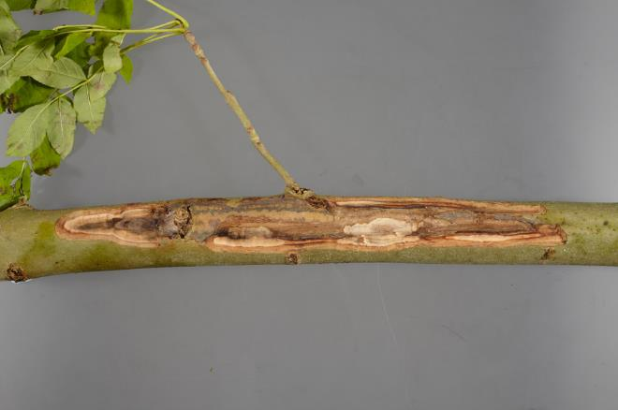
UK invasive species
Likewise, fungi and diseases can be carried around the world, and plenty are thriving in Britain.
Ash dieback (Hymenoscyphus fraxineus) is a devastating invasive fungus that threatens 95% of all European ash trees. Analysis suggests the spore came to Europe from Asia, where it grows on Asian ash trees without causing disease. It probably arrived in Europe on commercially imported ash.
Notes:
A lesion or canker on the branch of an ash tree.
Image: Wikimedia Commons (CC BY 2.0)

Slide 16
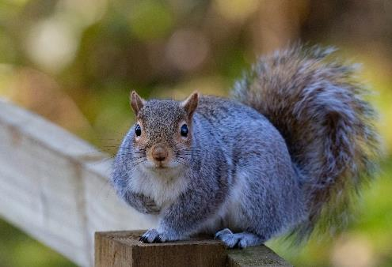
Example: grey squirrels (Sciurus carolinensis)
Grey squirrels are one invasive species almost everyone in the UK will have come across. Their fluffy tails can be spotted just about everywhere, from woodlands to inner city estates.
They were brought here from North America in the 1870s and introduced to private country estates, and it didn't take long for a wild population to successfully take over woodlands all over the country. Grey squirrels are considered an invasive species because they have outcompeted Britain's smaller, native red squirrels.

Slide 17
Example: grey squirrels (Sciurus carolinensis)
For about 10,000 years, red squirrels were found all over Britain, but their population numbers have suffered a catastrophic decline in the last century. It's due to a combination of factors:
grey squirrels carry a virus called squirrelpox, or Parapoxvirus, that they are immune to, but it can be deadly to their red cousins
grey squirrels breed quickly, but red squirrels do not
grey squirrels can be better at collecting nuts and berries, thus taking away food resources from red squirrels
red squirrels' natural habitat is being destroyed

Slide 18
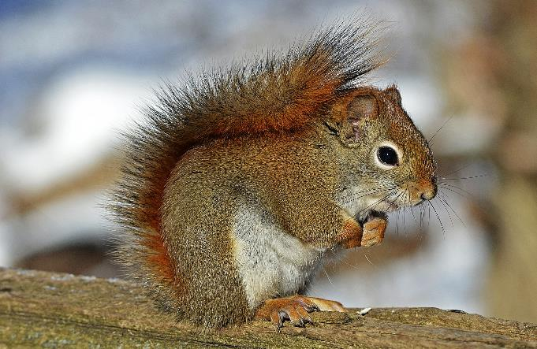
Example: grey squirrels (Sciurus carolinensis)
Now red squirrels only cling on in a few strongholds, including the woodlands of Scotland and the Isle of Wight.
Both populations need to be managed if conservationists are to save red squirrels from extinction within the next century.

Slide 19
Example: grey squirrels (Sciurus carolinensis)
Grey squirrels can also do damage to the trees they live in, in addition to competing with other arboreal species.
Their reputations as a pest species has led to their persecution, and they are often poisoned, trapped and killed. This route is not recommended by conservations or animal welfare advocates.
After all, the decline of the red squirrel is not the fault of any individual grey, rather it is the result of human mismanagement.
Notes:
Ecologists have recommended ways forward which don't involve killing grey squirrels, including actively planting conifer forests, which are preferred by red squirrels. But this has even more implications: new conifer forests should never replace or damage ancient, semi-natural woodland or other native habitats, but may be useful within a well-balanced strategy across a landscape together with planned forestry management.

Slide 20
Invasive species and climate change
Invasive species may become more widespread with climate change.
Climate change will be a bigger driver because a warming atmosphere is likely to allow more species to move further. In the UK, as our winters get warmer, more species will be able to survive them. It also gives species a longer growing season than they might have had before and could weaken native species who could have difficulty handling the warmer climate. It's a very complex issue.
Chris Raper
UK Species Inventory Manager
Natural History Museum

Slide 21
Invasive species and climate change
A changing climate could also affect the seasons by shortening or lengthening them. In the UK, there is evidence that butterflies emerge earlier during warm springs and summers.
If those butterflies were invasive, the changing timeframes could mean different plants are being eaten by insects during different times of year.
Climate change will inevitably result in animals and plants moving around the world, but that's not always going to be a bad thing.

Slide 22
Invasive species and climate change
Habitats are going to change because of the planetary emergency, so that may mean we need to manage them differently. We must work to conservation goals, which may not necessarily be the same as the preservation goals normally seen in habitat management targets.​
Stephanie Holt
UK Biodiversity Training Manager
Natural History Museum
​

Slide 23
Invasive species and climate change
Species heading into the UK as a result of
climate change need to be monitored in case they do become detrimentally invasive - but not all of them will. If we're thinking about global species conservation goals, not all species migration is a bad thing, as species adapt and change.
Climate change will result in winners and losers, and
we have to allow for migration as part of basic conservation principles in the future.
Stephanie Holt
UK Biodiversity Training Manager
Natural History Museum
​

Slide 24
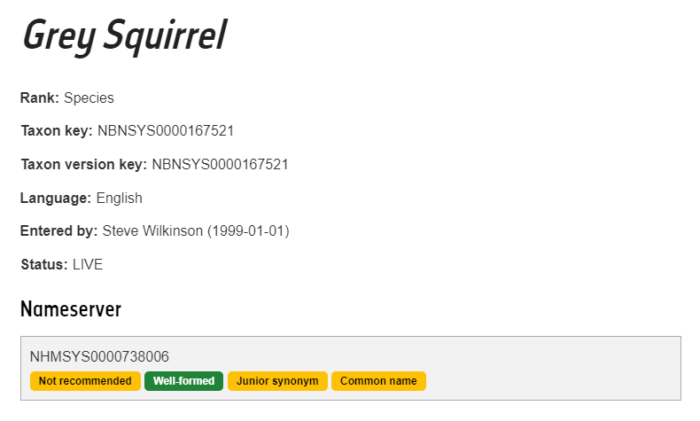
What can we do about invasive species?
Migrating and non-native species do not necessarily become invasive.
The first step in controlling invasive species is understanding the behaviour of new species coming into the country. Monitoring and good biological recording is an important part of this, and the UK relies on its network of experts, including the Museum, to help identify, record and monitor species.
Entry for the Grey Squirrel in the UK Species Inventory

Slide 25
What can we do about invasive species?
When a new species is identified, studies are made of its behaviour in its native habitat, because the species will not necessarily behave in the same way in a new environment potentially free from predators or disease. Whether or not a new species will thrive or become dominant in a new environment needs to be studied and understood.
Once a species is shown to be invasive and potentially damaging, it is monitored and, where possible, controlled. Control methods will vary depending on the species and might include anything from dissuasive planting to eradication.

Slide 26
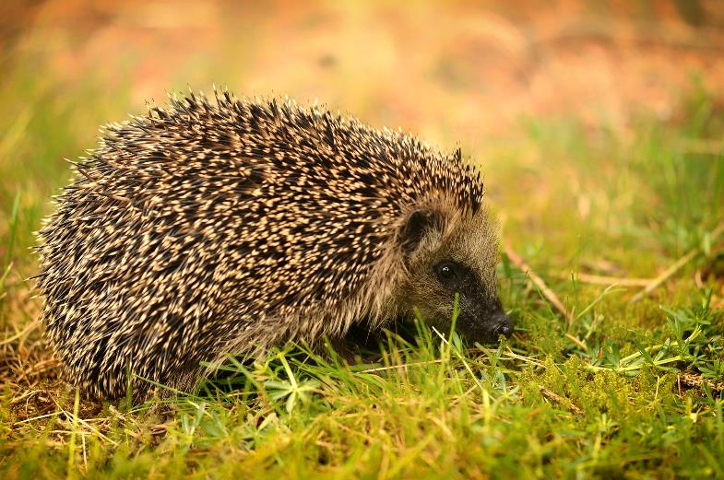
What can we do about invasive species?
For example, on Uist, off the Scottish coast, hedgehogs had to be removed and translocated back to the mainland. Although they are cute and seemingly harmless, they were introduced there in the 1970s and began eating wild bird eggs. The hedgehogs were then deemed an invasive species.

Slide 27
What can we do about invasive species?
Managing many non-native invasive species is
an ongoing problem, and many may remain a long-term
problem in many areas. However, there are many successful projects that have been run controlling the impact of some of these.
From a public perspective, the key is to be observant. There are certain known invasive species to be on the lookout for, especially plants. Some are still sold in garden centres, such as parrot's feather (Myriophyllum
aquaticum), an invasive water plant sold as an aerator in garden ponds. If it escapes into the wild it can cause havoc in native waterbodies. Technically it has been banned for sale since 2014, but does still crop
up misidentified in horticultural stock.
Stephanie Holt
UK Biodiversity Training Manager
Natural History Museum
​

Slide 28
What you can do to help
You might spot some invasive species, such as the Asian hornet, in your garden or out on a walk. If you do, these basic principles of good biological recording can help experts:
write down where you were, what you saw, when you saw it and who you are
take a photograph to help with verification
tell the landowner about a potential problem
add your records to iRecord and they will enter national databases to help researchers and conservationists monitor change
if you're not sure what you've found, ask the Museum's Identification and Advisory Service for help

Slide 29
What you can do to help
Don't try to pull up potentially invasive plants, or try to tackle the problem yourself, especially on land which is not your own. Species such as Japanese knotweed can be spread through tiny fragments which are easy to pick up on clothing or on boots and inadvertently spread to new sites.
Japanese knotweed, a species introduced as a horticultural import, may also have legal implications for landowners as it can rapidly spread across an area, swamping the native plants and the species they support. It can also regrow from a small fragment of root or stem and rapidly spread to and colonise a new area. As a result, by law, its presence and removal must be managed carefully.

Slide 30
What you can do to help
In addition, some invasives can be easily confused for other species. Some plants might also be inadvisable to touch, or might harm wildlife or livestock if left dried where they can access it.
Join your local Wildlife Trust or conservation society on an organised activity where you can participate in a coordinated effort with appropriate advice and guidance, which is likely to have a far more significant impact.

Slide 31
Nature on Your Doorstep video link:
https://www.youtube.com/watch?v=BD2eshvH3hk
​

Slide 32
What you can do to help
If you are concerned you may have invasive species on your land and you live in the UK, you can contact your statutory nature conservation organisation for advice:
Environment Agency
Natural England
Natural Resources Wales
Nature Scot
Department for Agriculture, Environment and Rural Affairs (Northern Ireland)

Slide 33
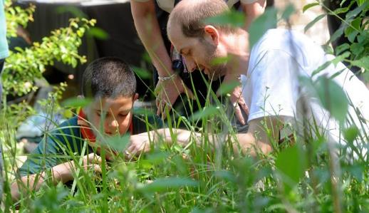
Community Science
Our community science projects invite you to actively contribute to the Museum's science research. By recording observations of wildlife, collecting samples, or transcribing handwritten records, you can unlock the potential of our collections and gather vital data for our scientists, helping them to better understand the natural world.
Anyone can take part - you don’t need special skills or training as we tell you everything you need to know to get involved. It’s a fun, free way to enjoy nature while doing a little bit of good in the world.
https://www.nhm.ac.uk/take-part/citizen-science.html

Slide 34
Urban Nature Project video link:
https://www.youtube.com/watch?v=jDgEkjBQ0gk
​

Slide 35
Useful links
http://www.nhm.ac.uk/discover/what-you-can-do-to-help-the-planet.html
http://www.nhm.ac.uk/discover/what-is-the-anthropocene.html
https://www.nhm.ac.uk/discover/news/2020/january/we-are-declaring-a-planetary-emergency.html
https://www.nhm.ac.uk/discover/news/2019/may/one-million-animals-and-plants-face-extinction.html
https://www.nhm.ac.uk/our-science/our-work/biodiversity.html
https://www.nhm.ac.uk/visit/our-broken-planet.html

