Slide 1
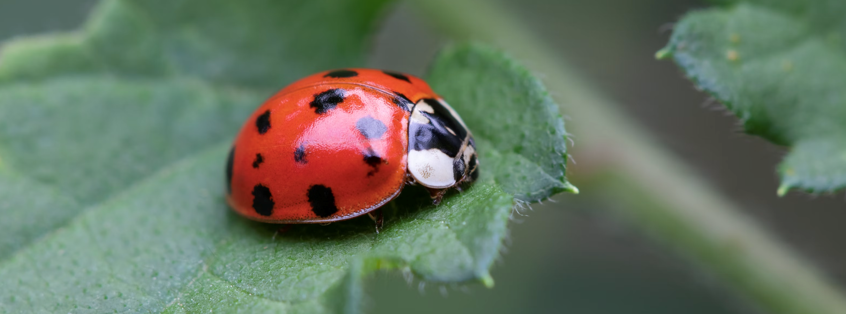
Ladybird genetics

Slide 2
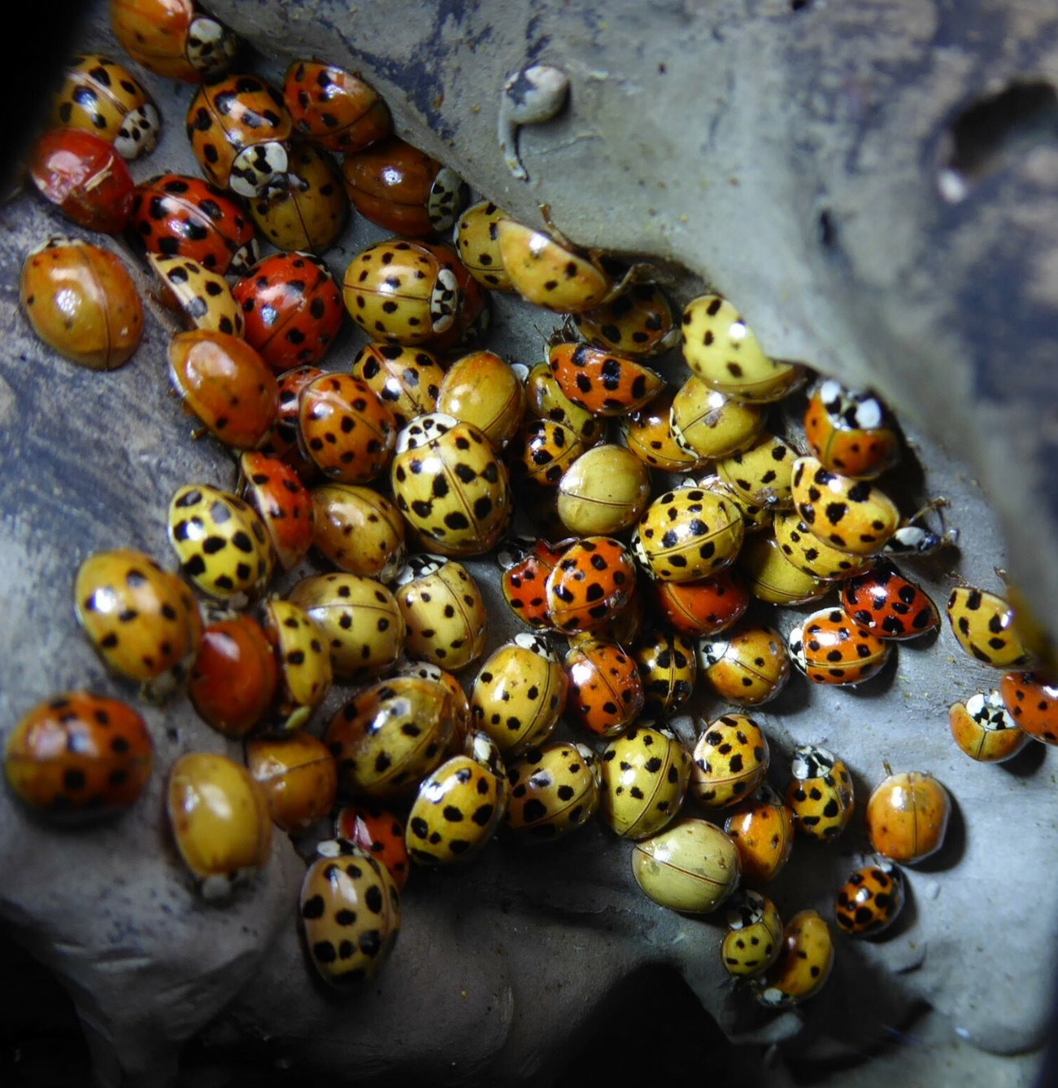
Vocabulary
Genome – The entire DNA sequence of an organism. (A recipe book)
DNA – The molecule which carries genetic information. (The language of the recipe book)
Genes – Sections of DNA which code for proteins. (Recipes within a recipe book.)
Alleles – Versions of a gene. (Spicy, mild etc. versions of a recipe)
Phenotype – Observable characteristics at the organism level. (What the dinner table looks like once all the dishes are on it.)
Ladybird genetics
Notes:
More good resources at Oak National Academy: Heredity and DNA (https://www.thenational.academy/teachers/programmes/science-secondary-ks3/units/heredity-and-dna/lessons)

Slide 3
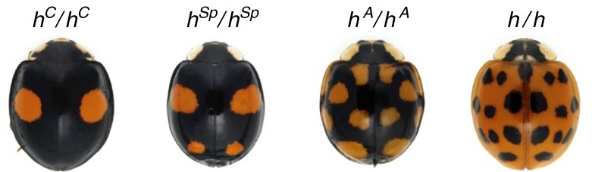
Genetic factors affecting colour
Pannier gene – promotes production of melanin (black pigments) and suppresses production of carotenoids (red/orange pigments)
In harlequin ladybirds, pannier has 4 major alleles associated with 4 common phenotypes. ¹
Four major alleles of the elytral colour patterns. h^{C}, conspicua; h^{Sp}, spectabilis; h^{A}, axyridis; h, succinea.
Adapted from Ando, T. et. al. (2018)
Ladybird genetics

Slide 4
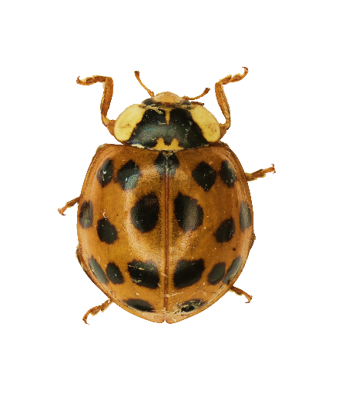
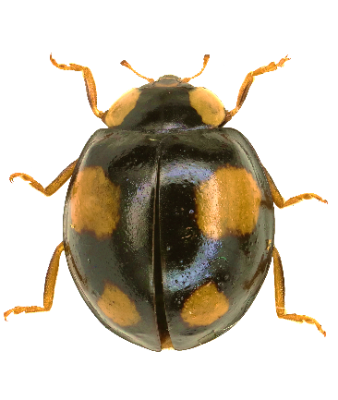
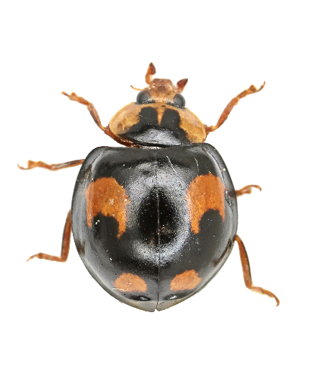
Parent 1
(H^{Sp}/H^{Sp})
Parent 2
(h/h)
At locations on the elytra where the pannier gene is expressed, the production of red pigments is suppressed and black pigments are laid down.
Pannier is a gene which shows mosaic dominance. Instead of a dominant allele silencing a recessive allele, both alleles are expressed.
Predict
What would happen if scientists blocked expression of the pannier gene?
Offspring
(H^{Sp} / h)
Ladybird genetics
Notes:
Try making the Parent 2 30% transparent and drag it over Parent 1. This should roughly produce the pattern in the offspring.
Because pannier shows mosaic dominance and promotes production of black pigment and suppresses red, wherever the parents had black colouring, the offspring has it as well.

Slide 5
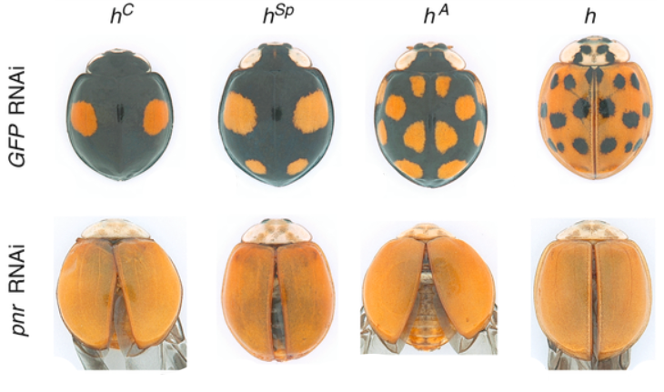
Genetic factors affecting colour
Researchers used RNA interference to silence expression of the pannier gene
Black pigment production in the elytra was very reduced, and red pigments were not affected.
With green fluorescent protein RNA interference (control)
With pannier gene RNA interference
Ladybird genetics
Notes:
Genome analysis indicated that the pannier gene was likely an important factor in determining the colour pattern for these ladybirds. To test this, researchers used RNA interference (RNAi) to silence the expression of the pannier gene.
RNAi is a process which happens in cells to control gene expression. Researchers can engineer RNA strands to target this process against specific genes. Here researchers took two groups of pupating harlequin ladybirds. One group received RNAi targeting pannier. The other group received RNAi targeting a green fluorescent protein (GFP RNAi). This was their control to try and confirm that it is the targeting of pannier which caused a change, not something about the injection of RNAi.
GFP RNAi–treated ladybirds showed the normal colour development.
Pannier RNAi–treated ladybirds had very reduced or no black pigmentation on their elytra.

Slide 6
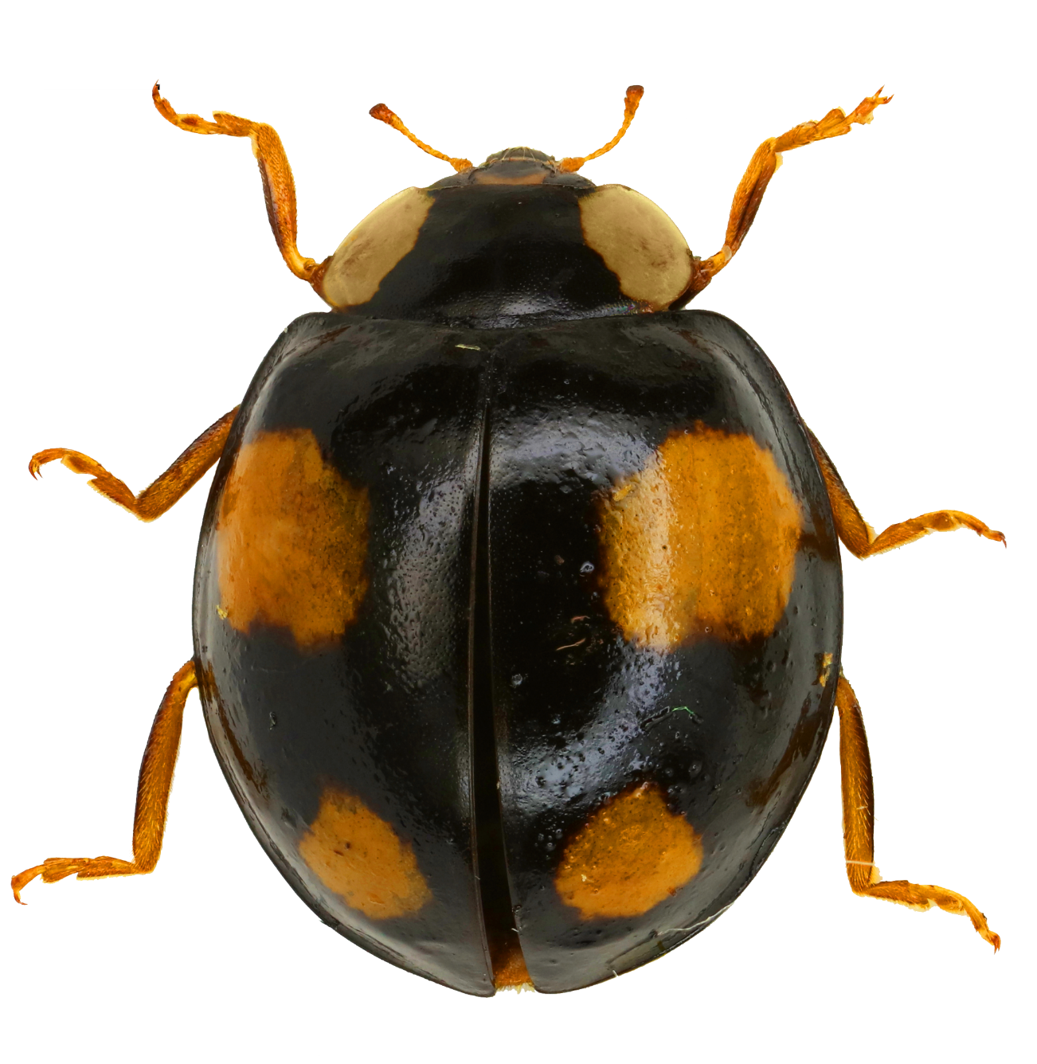
Discussion
Based on what we now know about how the pannier gene controls harlequin ladybird colour patterns…
Is this ladybird black with red spots
or
red with black spots?
Ladybird genetics

Slide 7
Explanation
This ladybird is red with big black spots.
Other genes control the production of red pigments and produce a red colour across the whole elytra. The base colour of the elytra is red.
The pannier gene affects the expression of these other genes, like a mask placed over top. Where the mask has holes, the red colour is able to show through.
Ladybird genetics

Slide 8
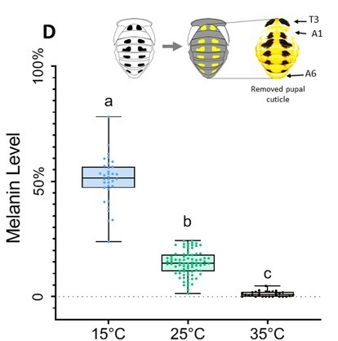
Environmental interactions
Size and colour of black spots is further affected by temperature sensitive genes.
Ladybirds pupating in colder temperatures develop more and larger black spots.
Hypothesize
Could producing more and larger black spots help ladybirds survive colder weather?
(Is it an adaptive feature?)
Melanin levels in pupal cases reared at 15, 25, and 35 degrees Celsius.
Adapted from Zhang, Y . et. al. (2021)
Ladybird genetics

Slide 9
Explanation
Black colouration absorbs more sunlight for warmth, allowing the ladybird to be more active on sunny days when cooler air temperatures might make other ladybirds less active.
Discussion questions
How could you design an experiment to test whether the hypothesis above is correct?
If climate change increases the spring temperatures in an area, what impact might this have on the prevalence of pannier alleles in the harlequin ladybird population?
Melanin levels in pupal cases reared at 15, 25, and 35 degrees Celsius.
Adapted from Zhang, Y . et. al. (2021)
Ladybird genetics

Slide 10
Sources
Ando, T. et. al. (2018). Repeated inversions within a pannier intron drive diversification of intraspecific colour patterns of ladybird beetles. Nature Communications. 9. 10.1038/s41467-018-06116-1.
Gautier, M. et.al. (2018). The Genomic Basis of Color Pattern Polymorphism in the Harlequin Ladybird. Current Biology. 28. 10.1016/j.cub.2018.08.023.
Zhang, Y . et. al. (2021). Aspartate-β-alanine-NBAD pathway regulates pupal melanin pigmentation plasticity of ladybird Harmonia axyridis. Insect science, 28(6), 1651–1663. https://doi.org/10.1111/1744-7917.12877
Ladybird genetics

Slide 11
We hope you found this resource useful!
Send your feedback to school-bookings@nhm.ac.uk
This resource was produced with support from Evolution Education Trust.

